Slide 1
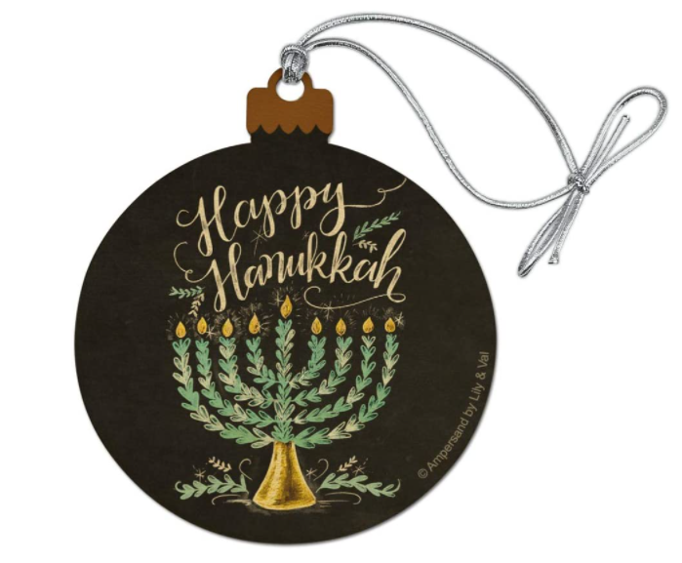
Kislev 5783 Nov 25-Dec 24
Physical Year Month: 3 = Camel, Provision, Lifted Up, Divine fullness, Trinity
Spiritual Year Month: 9 = Choice of Life or Death
Chanukah Begins- Feast of Dedication (Feast of Lights)
Fall Season – Season of Repentance
Monthly theme: Security/Hope, Trust, and Restful sleep.
Hebrew Tribe: Benjamin (Identity change: Named by mother Rachel for her pain; renamed by father “Son of my right hand”). Peaceful, but strong, warriors.
Hebrew letter- Samekh…Value= 60 Priestly blessing. Letter looks like a circle--To trust, support; to come full circle.
Characteristics—
Second chances at missed opportunities.
Also, a lattice– to lean upon, uphold, prop. As lattices
support grapevines in a vineyard.
Month of hope; month of dreams
Month to watch Israel (and to watch over Israel)
Shortest (darkest) day of the year—shine your light brighter.
Celebration of the lights (Chanukah) the light of His Mercies
never goes out. His mercies reign in the midst of destruction.
Constellation – SAGITARIUS, the Archer (Shoot straight, move
quickly, cut your losses and move on) Pull bow back with the
strong arm of the Lord. Dress in spiritual armor and stand strong.
Action - Sleeping (and Dreaming)
Body part- Stomach
Colors/Gemstone: Multicolored or Rainbow colored (Opal)
https://www.christinevales.com/

Slide 2
Kislev 5783 Nov 25-Dec 24
Physical Year Month: 3 = Camel, Provision, Lifted Up, Divine fullness, Trinity
Spiritual Year Month: 9 = Choice of Life or Death Chanukah Begins- Feast of Dedication (Feast of Lights)
Fall Season – Season of Repentance
Monthly theme: Security/Hope, Trust, and Restful sleep.
Hebrew Tribe: Benjamin (Identity change: Named by mother Rachel for her pain; renamed by father “Son of my right hand”). Peaceful, but strong, warriors.
Hebrew letter- Samekh…Value = 60 Priestly blessing. Letter looks
like a circle--To trust, support; to come full circle.
Characteristics—
Second chances at missed opportunities.
Also, a lattice– to lean upon, uphold, prop. As lattices
support grapevines in a vineyard.
Month of hope; month of dreams
Month to watch Israel (and to watch over Israel)
Shortest (darkest) day of the year—shine your light brighter.
Celebration of the lights (Chanukah) the light of His Mercies
never goes out. His mercies reign in the midst of destruction.
Constellation – SAGITARIUS, the Archer (Shoot straight, move
quickly, cut your losses and move on) Pull bow back with the
strong arm of the Lord. Dress in spiritual armor and stand strong.
Action - Sleeping (and Dreaming)
Body part- Stomach
Colors/Gemstone: Multicolored or Rainbow colored (Opal)
https://www.christinevales.com/

Slide 3
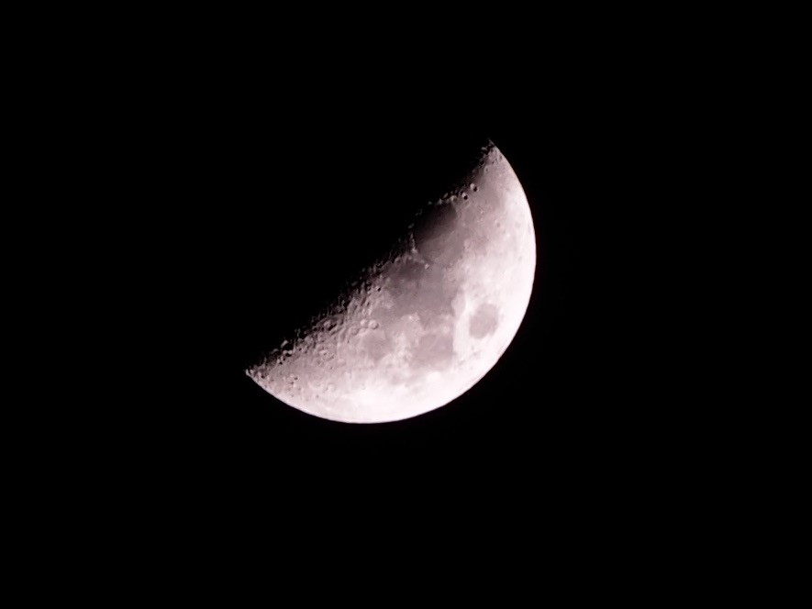
Releasing the Promise
I Will Pour Out My Spirit
“It will come about after this that I will pour out My Spirit on all mankind; And your sons and daughters will prophesy, your old men will dream dreams, your young men will see visions. Even on the male and female servants I will pour out My Spirit in those days.” Joel 2:28-29
What glorious promises we have been given! We labor together to see
Jesus Christ receive the rewards of His suffering from
the ends of the earth.
Declaration
Come Holy Spirit! You are welcome here. Come Holy Spirit and breathe upon the broken, fragmented structures of life and society. We come into agreement with God’s prophetic purposes and we declare that the power and presence of the Holy Spirit is being poured out in our families, neighborhoods, cities and nations. The older generation will receive dreams. The younger generation will receive dynamic visions. We will run together, and we will see with our own eyes the greatest global movement of the Holy Spirit in all history. These are the days prophesied by the prophets of old and we declare that a global outpouring of unprecedented power, purity and presence is now here. Amen and Amen!
NIGHTWATCH
THURSDAY
PRAYER

Slide 4
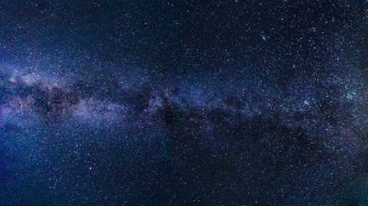
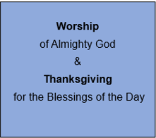
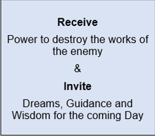
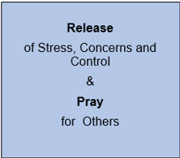
NIGHTWATCH INTERCESSORY PRAYERS

Slide 6
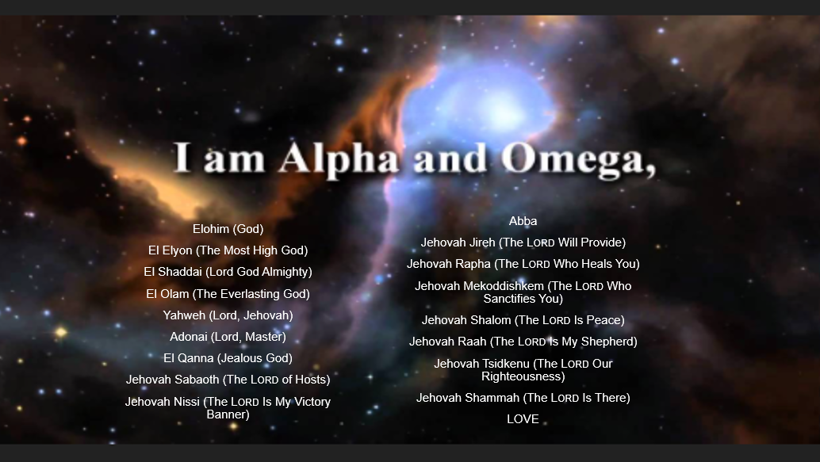

Slide 7
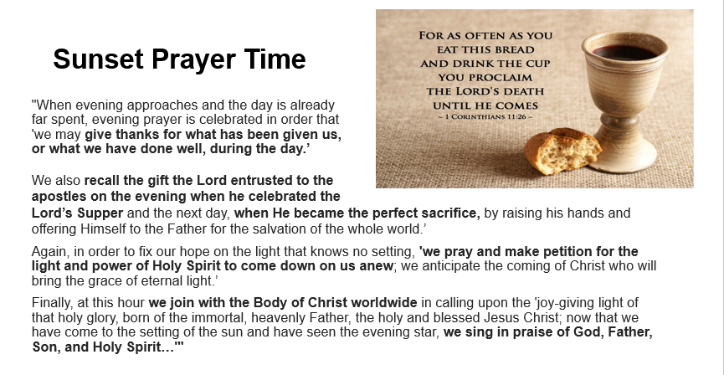
I am redeemed by the blood of the Lamb
out of the hand of the enemy.
When I receive your body and blood, Lord Jesus, I receive your eternal, divine and ABUNDANT LIFE.
Notes:
Celebration of the gift of Jesus, our Redeemer.
Thank You, Father, for this precious time of reflection on all that Christ did for us at Calvary. And as we partake of these hallowed symbols at this holy communion table, we humbly take this bread and bless it and break it, and eat it in remembrance of you, for Your own dear body was broken for us. May we continue to feed on You in our hearts, by faith and with grateful thanks from this day forward, and may we walk worthy of our calling in Christ Jesus and live a life that is honoring to You.
And Lord, may we also come to You today in grateful remembrance of what the Lord Jesus Christ achieved on Calvary’s cross for all or us, when He shed His precious blood on the cross, to pay the enormous price of our sin, and became a ransom for many. We share this cup of blessing in His name, remembering how He Himself took the cup in the upper room, as the hour of His crucifixion drew near and said, "this is My blood which is shed for many – do this, as often as you drink it, in remembrance of Me.“
Thank you, Jesus, for this holy sacrament and may we never approach the communion table in an unworthy manner, knowing that as often we eat this bread and drink the cup, we proclaim the Lord's death until His coming again, in great glory and majesty. Praise Your holy name. Amen.

Slide 8

Spirit of the living God,
Fall afresh on me.
Melt me, mold me, fill me, use me.
Spirit of the living God,
Rise up afresh in me.
And the disciples were filled with joy and with the Holy Spirit. Acts 13:52
Notes:
Welcoming of Holy Spirit- the gift of indwelling God

Slide 9

We Yield
Our Tongues to You!
Notes:
Pray in tongues- perfect unified worship and praise

Slide 10


Slide 11
We Surrender, Lord
Here we are, Lord. We trust that You have incredible plans for us. Tonight we surrender our whole being into Your care. We surrender life, plans and whole self- body, soul and spirit- to You.
We make ourselves 100% available to You tonight and always. Transform us. Transform our lives. Everything is on the table. Take what You want to take and give what You want to give.
Transform us into the people You created us to be so that we might live the lives You envisioned for us at the beginning of time. We are 100% available to You.
We hold nothing back. There is nothing we want to hold onto unless it pleases You and serves Your purposes. We trust Your love, Your plans and Your timing. We are 100% available to You.
Lead us, challenge us, encourage us and open our eyes to all Your amazing possibilities. Show us what You want each of us to do this evening and tomorrow. We are 100% available to You and, Jesus, we claim Your favor, Your protection and Your presence as we go through tonight and tomorrow.
We know that apart from You we can do nothing. But with joy we proclaim that nothing can ever separate us from You. Thank You, God! Amen
Notes:
One intercessor leads in this surrender prayer for the whole Body of Christ.
Then each intercessor submits personally.
Lead declares the authority we have been given “to resist the devil and he must flee”.

Slide 12
The LORICA (Alexander’s Breastplate Prayer)
On the face of the earth His equal was not born, Three persons of God, one gentle Son in the glorious Trinity. Son of the Godhead, Son of the Manhood, one wonderful Son. Son of God, a fortress, Son of the blessed Mary, Son, Servant, Lord.
Great His destiny, great God supreme, in heavenly glory. Of the race of Adam and Abraham, and of the line of David, the eloquent psalmist, was He born.
By a word He healed the blind and deaf from every ailment; the gluttonous, vain, iniquitous, vile, perverse, all to rise toward the Trinity by their redemption.
The Cross of Christ is our shining breastplate against every ailment. Against every hardship may it certainly be our city of refuge.
Notes:
Leader or intercessor claims this breastplate shield for every believer!

Slide 13
NIGHTWATCH INTERCESSORY PRAYERS

Slide 14
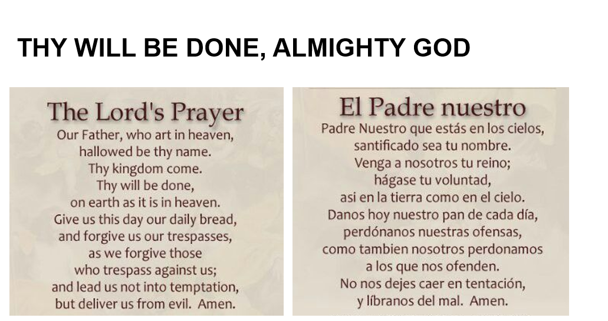
Notes:
All pray in unison to invite His Kingdom into the earth.

Slide 15
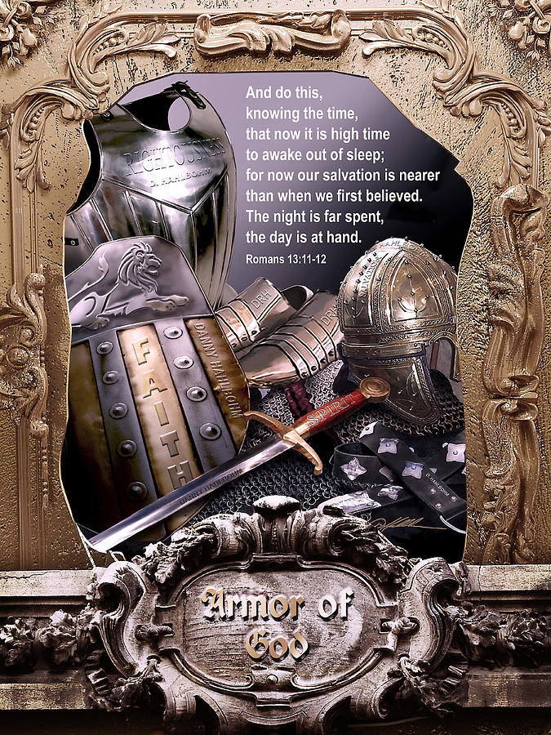
We Pray for Intercessors
Heavenly Father, we thank You for those who have devoted themselves to intercession for others. We pray that You will give all intercessors knowledge of Your will and that we will pray accordingly. Let us pray in confidence and power, knowing that because You are for us, nothing can be against us.
Give spiritual wisdom, understanding and insight to guide our prayers. Flood our hearts with Your light. Bring every intercessor to a new understanding of hope, and a new revelation of Your incredibly great power for those who pray, believing. Make our prayers fruitful.
Strengthen intercessors with all Your glorious power, and give them endurance in their ministry of prayer. Father, Creator of everything, we come boldly and confidently into Your presence.
Thank You, that from Your glorious and unlimited resources, You empower us with inner strength through Your Spirit. Holy Spirit, remind us always that Your power is greater than any earthly or demonic forces. Remind us that victory has already been paid for through Your atonement.
Bless Your vessels, Lord, and use Your Word in our mouths to pierce the darkness and destroy the works of the devil. Protect all prayer warriors as they take up the weapons of spiritual warfare. Fill every one with joy and thankfulness for answered prayers. As we fearlessly invade the adversary’s camp, let all intercessors go forth in the full armor of God, and may they be victorious in this war. May we be made complete with all the fullness of life and power that comes from You.
Give us servant hearts and through Your mighty power at work within each of us, may our prayers accomplish infinitely more for Your Kingdom than we might ask or think. Amen.

Slide 16
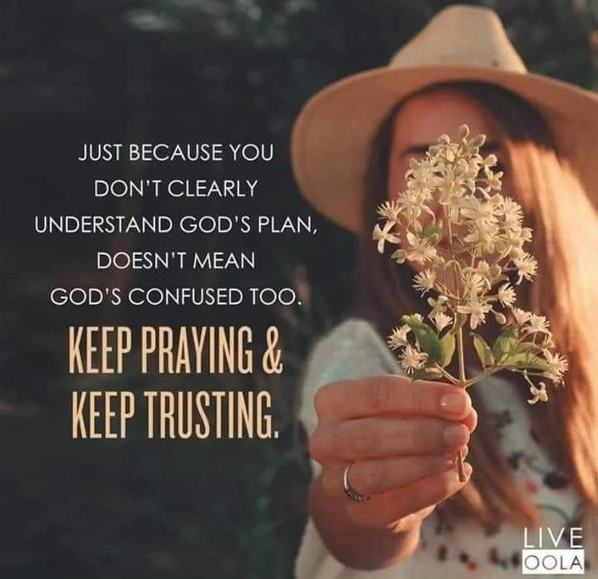
We Pray for Others
Heavenly Father, We lift up our brothers and sisters into Your presence. We know that You, in your love and awesome creative power, formed each and every one. You crafted their innermost parts and knit them together in their mothers’ wombs. You can make them whole in soul and body and You desire to do so.
We give thanks and praise to You, for fearfully and wonderfully making these precious ones. Thank you now for healing every infirmity and restoring every mind and heart and body back to newness of life.
Wonderful are Your works! We know this so well. And wonderful is Your love and mercy for us always. Thank you, Creator God, that our frames are not hidden from You, and we have no needs that You, in Your great goodness, cannot satisfy. You are our all-sufficiency and You are more than enough, always enough and forever enough.
In Your book are written all the days appointed for each of these petitioners. We pray that those days will be fulfilled in prosperity… nothing missing, nothing broken because that is Your nature. Your promises are real and trustworthy, and Your love never fails us.
Psalm 139:13-16
Notes:
Intercession and repentance to remove obstacles that hinder prayers.
Leader asks one intercessor to claim the promises for our brothers and sisters in the book. (They can read what’s written or pray in their own words.)
All intercessors repent for doubt, unbelief, sin…any obstacle that hinders prayer, on behalf of those we are praying for. Ask for mercy and grace over our ignorance.

Slide 17
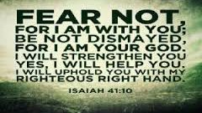
Notes:
Leader declares that God’s perfect love casts out fear.
All intercessors pray as the Spirit leads to release love and drive out fear in every form from our territory and away from those we are praying for.

Slide 18
We Release Your Blessing, Lord
  Bodies—wellness/wholeness and immunity; protection
  Livelihoods and labor; work, income, security
  Emotions—Freedom from fear; joy, peace and hope
  Social – Relationships; love, marriage, family, friends
  Spiritual—salvations and faith and grace
Notes:
Everyone prays for the petitions. Leader ensures that someone is covering each group.

Slide 19
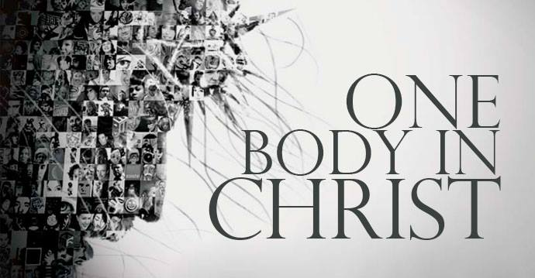
Prayers for Christ’s Body
Heavenly Father, we praise and thank You for the many people throughout our world that have come to trust in the finished work of Jesus Christ at Calvary, and that together we make up the body of Christ and are united in Him.
May we be faithful to lift up our brothers and sisters in Christ, wherever they may be. We pray that each one may be filled to overflowing with the knowledge of Jesus Christ our Savior.
May each of Your children be granted all spiritual wisdom, grace, understanding and love for each other, so that through the power of Your Holy Spirit we may walk worthy of our calling in Christ.
We pray that Your Body may grow in unity and love, not compromising with worldly standards but walking in spirit and truth, living a life that is pleasing to You in thought, word and deed.
Strengthen each one we pray, with all power, according to Your riches in glory, so that together as one we may show forth the beautiful fruit of the Spirit and be endowed with steadfastness and patience, wisdom and love.
Keep us ever looking to Jesus, and may the wonder and joy we have in Him continue to grow in His grace, until we stand before His very Presence, when He comes to take us to be with Himself forever. Thank You, that Your Word contains all we need to live godly in Christ Jesus and to walk in spirit and truth. In Jesus' name, Amen.
Notes:
Leader or intercessor prays for the Body of Christ.
Intercessors are encouraged to call out specific churches and ministries to bless as they pray for the new wineskin church.
Source: https://prayer.knowing-jesus.com/Prayers-of-Intercession

Slide 20
LEADER Blessings
Made in the Powerful Name of Jesus Christ…
APOSTLES…EVANGELISTS…PROPHETS…PASTORS…
WORSHIP LEADERS…MINISTRY LEADERS
DIVINE PROTECTION Let no weapon formed against them prosper. May no tongue that speaks against them prevail. (Isaiah 54:17)
REST and REFRESHING
3. FREEDOM Ensure that they cannot be cursed.they cannot be cursed. (Numbers 23:8,20)
DESTINY Bless every God-appointed assignment they put their hands to. Keep them from distractions and tasks You haven’t given. (Deuteronomy 28:8)
GRACE Keep them in humility. Guard them from Pride and hold them close to Your heart. (2 Corinthians 12:9)
VICTORY When enemies come against them one way they will be forced to flee before them 7 ways. (Deuteronomy 28:7)
BLESSING They are fully resourced, lacking nothing as they accomplish their assignments in God on behalf of the Body of Christ and fulfil their personal destinies. (Ephesians 1:3)
Notes:
Leader invites one intercessor to pray over all leaders, using these points or as led by Holy Spirit.
All call out specific leader names to bless them and release God’s Hand over them. Pray it out in the Spirit.

Slide 21
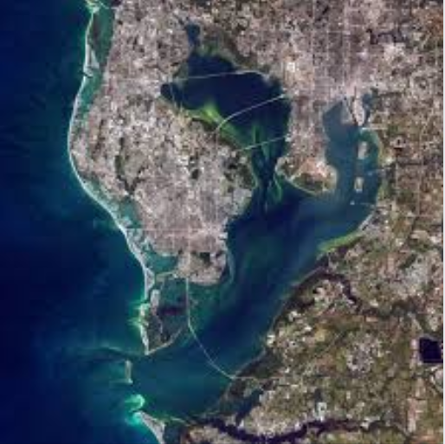
Intercessors pray in the Spirit over all mountains of influence.
As directed by Spirit, assigned Intercessors declare 1-2 “lightning strikes” for each influence mountain.
“We decree that media will speak truth only. The voice of the enemy will be silent over the airwaves.”
FAMILY
EDUCATION
RELIGION
GOVERNMENT
BUSINESS
ARTS & ENTERTAINMENT
MEDIA
Notes:
Ask one person to lead off in prayer over the Family. Then invite others to add to the petitions until all have been covered. (This prayer is for families and our future generations.)
Pray for fathers to become high priests in their homes, for marriages to include Jesus in the relationship and for love, mercy and grace to abound.
Lay an axe to the root of every demonic strategy and tactic to destroy the family and our children.

Slide 22
FAMILY
Perhaps the area most under assault is that of the family. The devil seeks to steal, kill and destroy the family unit. Why? Because it is at the core of who we are and what God intends for us to be. Satan knows if he goes for the jugular—our family unit—he has us right where he wants us—crumbling and falling apart.
In the all powerful name of Jesus…
We decree the complete eradication of premarital sex, cohabitation, divorce, pornography, abuse, neglect, abortion and same-sex marriage and all practices that are a direct assault on the family in America. We decree the reversal of all legislation that supports or protects these practices.
We decree and declare that marriage between one man and one woman will remain the foundation of the family in America. There will be no negative legal or financial impact for couple who desire to come together in holy matrimony.
We pray that fathers will take their place as priests in the home, submitting to the sanctification of the Lord to be made holy and equipped to renounce family curses and loose blessings over current and future generation.
We pray that Christian families will have the spiritual understanding to effectively engage in spiritual warfare and release God’s protection and angels for their families.
We pray that broken marriages will be restored, healed and strengthened. We command the spirit of divorce, abuse, strife and offense out of all godly marriages as evidenced by plummeting divorce rates.
We call all believers to stand for life and boldly defend the unborn. We call forth laborers, resources & support to be provided for unwed and single mothers who choose to carry their babies and give them the opportunity of life.

Slide 23
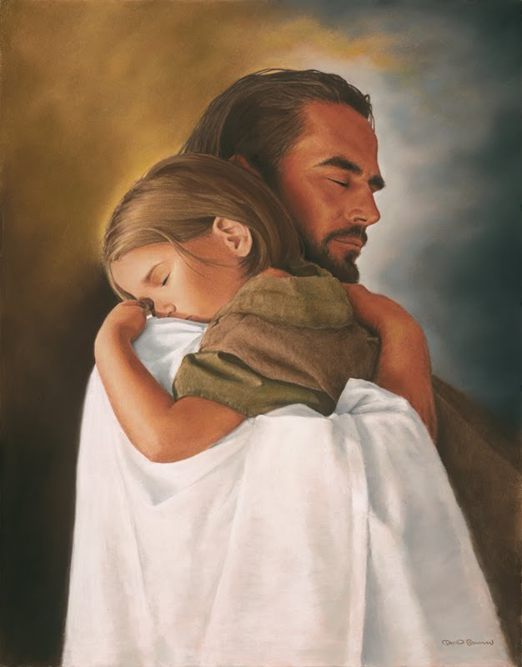
We Pray for Our Children and Families
WE POUR OUT HOLY SPIRIT POWER UPON OUR SONS AND OUR DAUGHTERS, OUR CHILDREN AND FUTURE GENERATIONS.
As Joel prophesied, Holy Spirit power is coming upon our children, teenagers, and young adults. Male and Female. All flesh. We call forth this emerging generation to ALL rise up and serve our God and build Christ’s Kingdom.
We pray they will experience holy visitations and prophesy, dream God’s dreams, see His vision and fulfill their divine destinies. We release them to carry His presence in their generation. Their commitment to Christ the King is going to startle the world, and it’s going to be contagious.
ALL: Awakening, be. Revival, be. Reformation, come and keep on coming. Revival fires, burn through this nation and around the world.”
Notes:
Lead or intercessor makes this proclamation. All pray in agreement and release it over the Body in the Spirit.
Source: Sheets, Tim. Planting the Heavens (p. 100). Destiny Image, Inc.. Kindle Edition.

Slide 24
We Pray for and Receive MERCY… America shall be saved!
“Father God, in the name of Jesus Christ, we lift up the United States of America to You and stand in the gap for her before You. We repent for the willingness of our leaders to see her fall. We repent for ourselves, America’s citizens, for not having been vigilant to guard the gift You gave us. Before You Almighty God, we call those sins our own, we bring them to the Cross, and ask You to remove them from us and from this land. According to Your Word, we speak this word of repentance over the United States of America: We repent, Lord, and hear You say, “So do not fear, for I am with you; do not be dismayed, for I am your God. I will strengthen you and help you; I will uphold you with My righteous right hand. Instead of the tyranny of the present, I will appoint peace as your officers and righteousness as your taskmasters. Violence shall no more be heard in your land, nor devastation or destruction within your borders, but you shall call your walls Salvation and your gates Praise.
At Your word, we claim the promise “Your people also shall all be uncompromisingly and consistently righteous; they shall possess the land forever, the branch of My planting, the work of My hands, that I may be glorified. And they shall rebuild the ancient ruins; they shall raise up the former desolations and renew the ruined cities, the devastations of many generations.
Because of Your great mercy, we claim the promise “Instead of your former shame, you shall have a twofold recompense; instead of dishonor and reproach, your people shall rejoice in their portion. Therefore, in their land they shall possess double what they had forfeited; everlasting joy shall be theirs. For I, the Lord, love justice;
Heavenly Father and gracious Lord, hear us as we declare “Listen, O heavens, and we will speak; hear, O earth, the words of my mouth. We will proclaim the name of the Lord. Oh, praise the greatness of God! He is the Rock. His words are perfect, and all of His ways are just. A faithful God Who does no wrong, upright and just is He”. And, in the name of Jesus Christ, we loose this nation from every assignment of satan set against her. And in His name, we bind Your promises, Father, to her. Thank You for Your healing work in this land, precious Lord. Amen.”
Notes:
One intercessor prays this prayer.
Every intercessor prays for our nation as led by the Spirit.
After praying, leader asks each intercessor what they prayed for specifically.
Make sure we continue to pray for JUSTICE over 2020 election, Jan 6, Benghazi, attacks on Trump…any other know injustices.

Slide 25
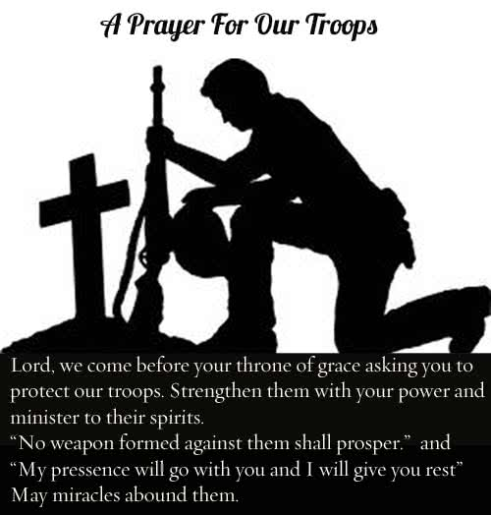
Oh Almighty God,
Whose great power and eternal wisdom embraces the universe, watch over all military and law enforcement officers.
Protect them from harm in the performance of their duty to stop corruption, theft, crimes, riots, and violence.
We pray, help them keep our streets and homes safe day and night. Help them to foil every enemy strategy and attempt to bring harm to the innocent.
We commend them into Your loving care because their duty is dangerous. Grant them your unending strength and courage in their daily assignments. Give them wisdom and discernment as they accomplish Your righteous will.
Heavenly Father, protect these brave men and women, grant them your almighty angels for protection, and unite them safely with their families after duty has ended.
In the name of Jesus, the Good Shepherd, we pray. Amen

Slide 26
We pray for ISRAEL-2
Almighty God, Thwart the Tower of Babel strategy of the enemy to take and divide Jerusalem and to replace You on the throne in Israel. Send angels to guard and war on behalf of Your great name and purposes.
Holy Spirit, please intervene in the current situation of Israel and protect them from the slander and lies of the United Nations and others: “When the enemy comes in like a flood, The Spirit of the Lord shall lift up a standard against him” (Isaiah 59:19).
Lord, turn the hearts of the people of Israel to trust in the name of the Lord for deliverance –not in the ‘chariots or horses’ of their military might (Zechariah 4:6). Save them from pride, self reliance and trusting in false ideologies – humanism, socialism, communism...
God of the harvest, we ask for laborers in preparation for the soul harvest. Raise up elders and young leaders to teach and train the new generation of young Israelis who are coming to faith in the Messiah.
We pray for “Palestinian Arabs” to come to faith in Christ and embrace God’s end-time purpose for Israel: send forth more laborers to bring an appointed harvest from the whole Middle East.
We pray that Israel’s relationship with the United States will remain strong and uncompromised. May our nation-and especially young believers- recognize and support God’s purposes for Israel and reject the lies and compromises of a two-state solution, a division of Jerusalem...
Lord, we ask young believers in America would come to love the Jewish people as they seek to prepare the way for the return of the Messiah. May every voice of antisemitism and replacement theology be silenced.
Notes:
On behalf of the whole group, Leader assigns:
One intercessor to pray for Israel. May use these prayer points or not, as desired. >30 secs
Others may add to this prayer with additional points
Then, ALL pray as the Spirit leads. >30 secs

Slide 27
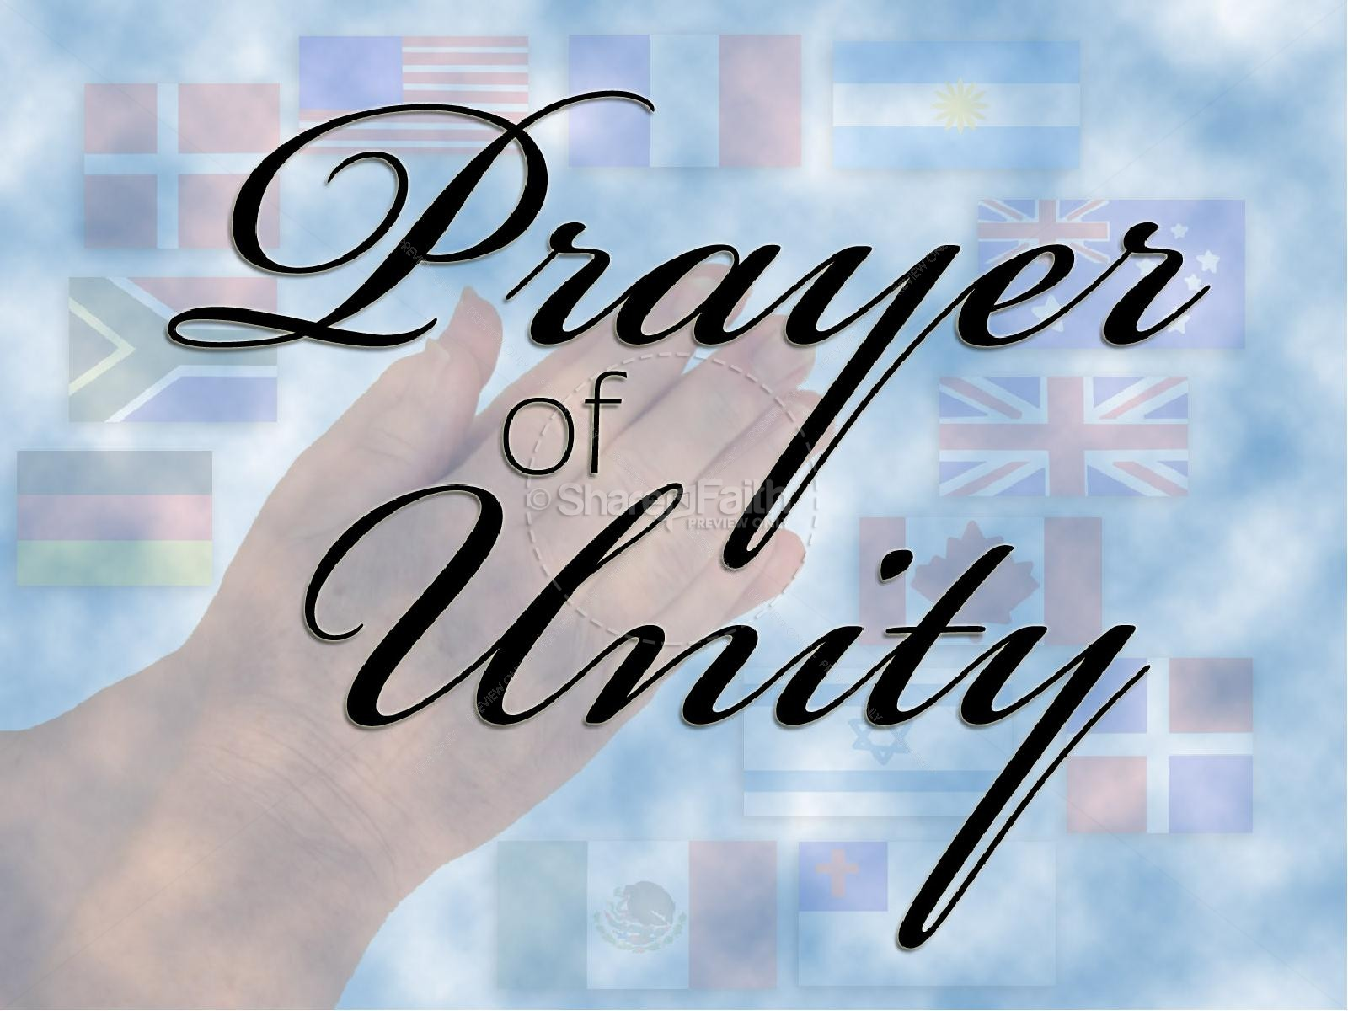

Notes:
On behalf of the whole group, Leader assigns: (They pray one after the other)
One intercessor to pray for the nations of the earth. >30 secs
One intercessor to pray for the persecuted church. >30 secs
Then, ALL pray as the Spirit leads. >30 secs

Slide 28
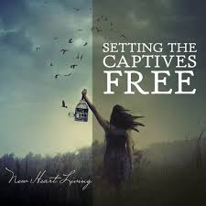
Blessing Prayer for the World
May God be gracious to us and bless us; may He make His countenance shine upon us forever; that Your way be known on earth, Your salvation among all nations. The nations will extol You, O God; all the nations will extol You. The nations will rejoice and sing for joy, for You will judge the peoples justly and guide the nations on earth forever.
The peoples will extol You, O God; all the peoples will extol You, for the earth will have yielded its produce and God, our God, will bless us. God will bless us; and all, from the farthest corners of the earth, shall fear Him.
We implore You, by the great power of Your right hand, RELEASE EVERY CAPTIVE. Accept the prayer of Your people; strengthen us, purify us, awesome One.
Mighty One, we beseech You, guard as the apple of the eye those who seek You. Bless them, cleanse them; bestow upon them forever Your merciful righteousness.
Powerful, holy One, in Your abounding goodness, guide Your congregation. Only and exalted One, turn to Your people who are mindful of Your holiness. Accept our supplication and hear our cry, You who knows secret thoughts.
Blessed be the name of the glory of Christ’s Kingdom forever and ever.
Let the heavens rejoice, let the earth be glad; let the sea resound, and all that is in it. Ps 96:11
Notes:
On behalf of the whole group, Leader assigns: (They pray one after the other)
One intercessor to pray for the World. >30 secs
One intercessor to pray for the persecuted church. >30 secs
Then, ALL pray as the Spirit leads. >30 secs

Slide 29
Notes:
Leader invites intercessors to pray, one after the other, for the water, air, land, energy fields, and food supply.
Then, ALL pray as the Spirit leads. >30 secs

Slide 30
NIGHTWATCH INTERCESSORY PRAYERS

Slide 31
We Release PROSPERITY
The LORD shall command the blessing upon thee in thy storehouses, and in all that thou settest thine hand unto; and he shall bless thee in the land which the LORD thy God giveth thee. Deuteronomy 28:8
And you shall remember the LORD your God, for it is He who gives you power to get wealth, that He may establish His covenant which He swore to your fathers, as it is this day. Deuteronomy 8:18
Honor the Lord with thy substance and with the first fruits of all your increase: so shall your barns be filled with plenty, and your presses shall burst out with new wine. Proverbs 3:9
The blessing of the LORD brings wealth, and he adds no trouble to it. Proverbs 10:22
He is like a tree planted by streams of water, which yields its fruit in season and whose leaf does not wither. Whatever he does prospers. Psalm 1:3
He will be like a tree planted by the water that sends out its roots by the stream. It does not fear when heat comes; its leaves are always green. It has no worries in a year of drought and never fails to bear fruit. Jeremiah 17:8
My God will meet all your needs according to his glorious riches in Christ Jesus. Philippians 4:19
we know the grace of our Lord Jesus Christ, that he was rich, yet for our sakes he became poor, so that we through his poverty might become rich. 2 Corinthians 8: 9
And God is able to make all grace abound toward us; that we will always have all sufficiency in all things, so that we may abound to every good work. 2 Corinthians 9:6
Notes:
Leader invites all intercessors to plant 1-2 promises from God’s Word and then pray as the Spirit leads. >30 secs

Slide 32
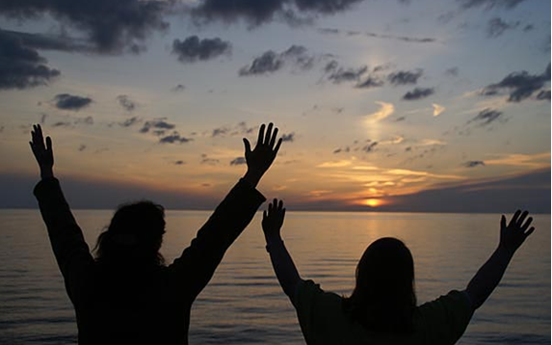
"Let the whole earth sing to the Lord!
Each day proclaim the good news that He saves.
Publish His glorious deeds among the nations.
Tell everyone about the amazing things He does.
Great is the Lord! He is most worthy of praise!
He is to be feared above all gods.
The gods of other nations are mere idols, but the Lord made the heavens!
Honor and majesty surround Him; strength and joy fill His dwelling. O nations of the world, recognize the Lord, recognize that the Lord is glorious and strong.
Give to the Lord the glory He deserves!
Bring your offering and come to worship him.
Worship the Lord in all His holy splendor."
1 Chron 16:23-29 NLT

Slide 33
Deuteronomy 28:1-14
The Lord your God will set you high above all nations of the earth. And all these blessings shall come upon you and overtake you…
“The Lord will cause your enemies who rise against you to be defeated before your face; they shall come out against you one way and flee before you seven ways.
“The Lord will command the blessing on you in your storehouses and in all to which you set your hand, and He will bless you in the land which the Lord your God is giving you.
“The Lord will establish you as a holy people to Himself, just as He has sworn to you… all peoples of the earth shall see that you are called by the name of the Lord…
And the Lord will grant you plenty of goods, in the fruit of your body, in the increase of your livestock, and in the produce of your ground, in the land of which the Lord swore to your fathers to give you.
The Lord will open to you His good treasure, the heavens, to give the rain to your land in its season, and to bless all the work of your hand.
You shall lend to many nations, but you shall not borrow. And the Lord will make you the head and not the tail; you shall be above only, and not be beneath…

Slide 34
PROSPERITY Prayers
Prayer One: Thank You for Your promises of material abundance for our lives. You do not will poverty and need, any more than You will sin and sickness. We are thankful to know Your great salvation (Hebrews 2:3) delivers us not only from our sins, but from their consequences as well­—from all the works of the devil (1 John 3:8) sent to steal, kill, and destroy our lives and destinies. (John 10:10). When You created material abundance in this earth, You demonstrated that You want Your children to enjoy it and to utilize it. You placed rich treasures here (Genesis 2:9-14), not for un-believers to monopolize, but for the prosperity, facility and blessing of Your children who carry out Your will among people. THANK YOU, LORD. Your Word says, we shall not lack any good thing (Psalm 34:10). You shall supply all our needs (Philippians 4:19). You wish, above all things that we prosper and be in health, even as our souls prosper (3 John 2).
Prayer Two: Thank You, Lord, that You have pleasure in the prosperity of Your servants (Psalm 35:27). Thank You for Your promise to make us plenteous in goods (Deuteronomy 28:11). We believe that You have commanded Your blessing upon us…in all that we set our hands to (Deuteronomy 28:8). I believe that Christ redeemed me from the curse (Galatians 3:13) of poverty and evil, of lack and destitution. We will, from this day, honor You with substance and with the firstfruits (not leftovers) of all our increase: so shall our barns be filled with plenty (Proverbs 3:9-10). We understand that loving is giving, and giving is planting, and whatever we sow, we shall also reap—more (Galatians 6:7). We will begin planting. And since You are the God of miracles, we know that even if it requires a material miracle, like multiplying the boy’s lunch to feed a multitude (Matthew 14, Mark 6, Luke 9, John 6), You will do it to guarantee our harvest. Your Word cannot return to You void (Isaiah 55:11) and the Scriptures cannot be broken (John 10:35). We now realize that, although there is suffering and poverty around us, this is Satan’s work—not Yours. You do not will these evils any more than You will that we live in sin.

Slide 35
PROSPERITY Prayers
Prayer Three: I now know that the earth is the lord’s and the fullness thereof (1 Corinthians 10:26). We realize now that riches and wealth are the gift of god (Ecclesiastes 5:19). So long as we do not love money (1 timothy 6:10) or seek to store it up or trust in riches (mark 10:24, 1 timothy 6:17), you will make our ways prosperous, and we shall have good success Joshua 1:8). We will bring our first-fruits (the first and best), tithes and offerings to you for your work, as you commanded (Malachi 3:10), and we shall prove your word by acting upon it. We believe you will open heaven’s windows and pour out blessings and harvests of much more than we bring to you, according to your promise (Malachi 3:10) We are your children. You are our father. We have roots in divine royalty (2 Corinthians 6:16, 1 peter 2:9). You were rich, yet for our sake you became poor, that through your poverty we might be made rich (2 Corinthians 8:9).…Materially as well as physically and spiritually. You are our creator and you live in us. We claim our place in your royal family where prosperity is regained. Amen!

Slide 36
Hope Promises
Acts 2:25-26 “For David says concerning Him: ‘I foresaw the Lord always before my face, for He is at my right hand, that I may not be shaken.”
ALL: Therefore my heart rejoices, and my tongue is glad; Moreover my flesh also rests in hope.
2. 1 Peter 1:13 “Therefore gird up the loins of your mind, be sober, and rest your hope fully upon the grace that is to be brought to you at the revelation of Jesus Christ;”
ALL: Thank you for revealing Yourself and Your grace to us. Our hope rests entirely on You.
Hebrews 3:6 “But Christ, as the Son, is in charge of God’s entire house. And we are God’s house, if we keep our courage and remain confident in our hope in Christ.”
ALL: Help us, Holy Spirit, to be courageous and confident for our trust is in Christ, the conquering and victorious King.
4. Hebrews 6: 10-12 “For God is not unjust to forget your work and labor of love which you have shown toward His name, in that you have ministered to the saints, and do minister. And we desire that each one of you show the same diligence to the full assurance of hope until the end, that you do not become sluggish, but imitate those who through faith and patience inherit the promises.”
ALL: Thank you for our unshakable assurance that You will keep us to the end. Our hope is in You alone.
5. Hebrews 6 “So God has given both his promise and his oath. These two things are unchangeable because it is impossible for God to lie. Therefore, we who have fled to him for refuge can have great confidence as we hold to the hope that lies before us. This hope is a strong and trustworthy anchor for our souls. It leads us through the curtain into God’s inner sanctuary.”
ALL: The hope You give us is a strong and trustworthy anchor for our souls. Thank You for holding us firm.

Slide 37
Hope Promises -2
1. Hebrews 10:23 “Let us hold fast the confession of our hope without wavering, for He who promised is faithful.”
ALL: Holy Spirit, grant us unwavering faith and strong confessions of hope as a light in this dark world.
2. Romans 5:5 “Now hope does not disappoint, because the love of God has been poured out in our hearts by the Holy Spirit who was given to us.”
ALL: Our hope in You will never disappoint us. You are perfect love. You never change and love never fails.
3. Romans 8:24-25 “For we were saved in this hope, but hope that is seen is not hope; for why does one still hope for what he sees? But if we hope for what we do not see, we eagerly wait for it with perseverance.”
ALL: We will hold onto to hope as our title deed until we see its manifestation. May our anticipation be great as we wait for our promises.
4. 2 Thessalonians 2:16-17 “Now may our Lord Jesus Christ Himself, and our God and Father, who has loved us and given us everlasting consolation and good hope by grace, comfort your hearts and establish you in every good word and work.”
ALL: We receive Your comfort and guidance as we walk out our divine destinies and Your Kingdom purposes.

Slide 38
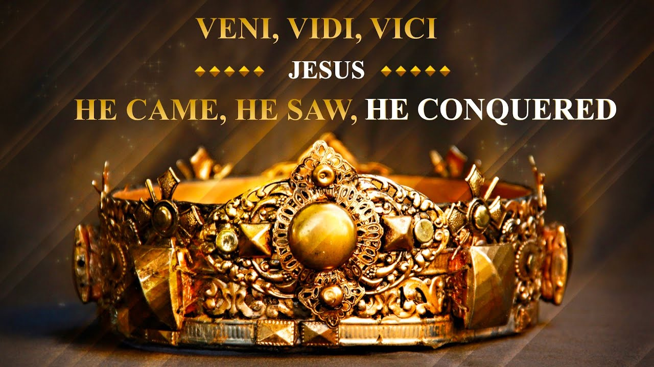
There is a King
There is a king seated among us. Let every heart receive Him now. Where there is praise, He will inhabit; there will be grace and mercy all around.
Every burden will be lifted in His presence and every trophy will be laid down at His feet. There is a name that reigns above all others—Jesus Christ, the king above all kings.
Unto the Lamb, honor and glory; Worthy is He who overcame. Buried in shame, risen in power, He is alive and the stone is rolled away.
All our worship will belong to Him forever. Death is conquered and our Savior holds the keys. There is a name that reigns above all others—Jesus Christ the king above all kings.
It won't be long we will behold Him and every tear He'll wipe away. We'll be at home, the war will be over. Soon we will meet our Savior face to face.
All our worship will belong to You forever. Holy, holy for all eternity. Yours is the name that reigns above all others. Jesus Christ the King above all kings. Jesus Christ the King above all kings.

Slide 39
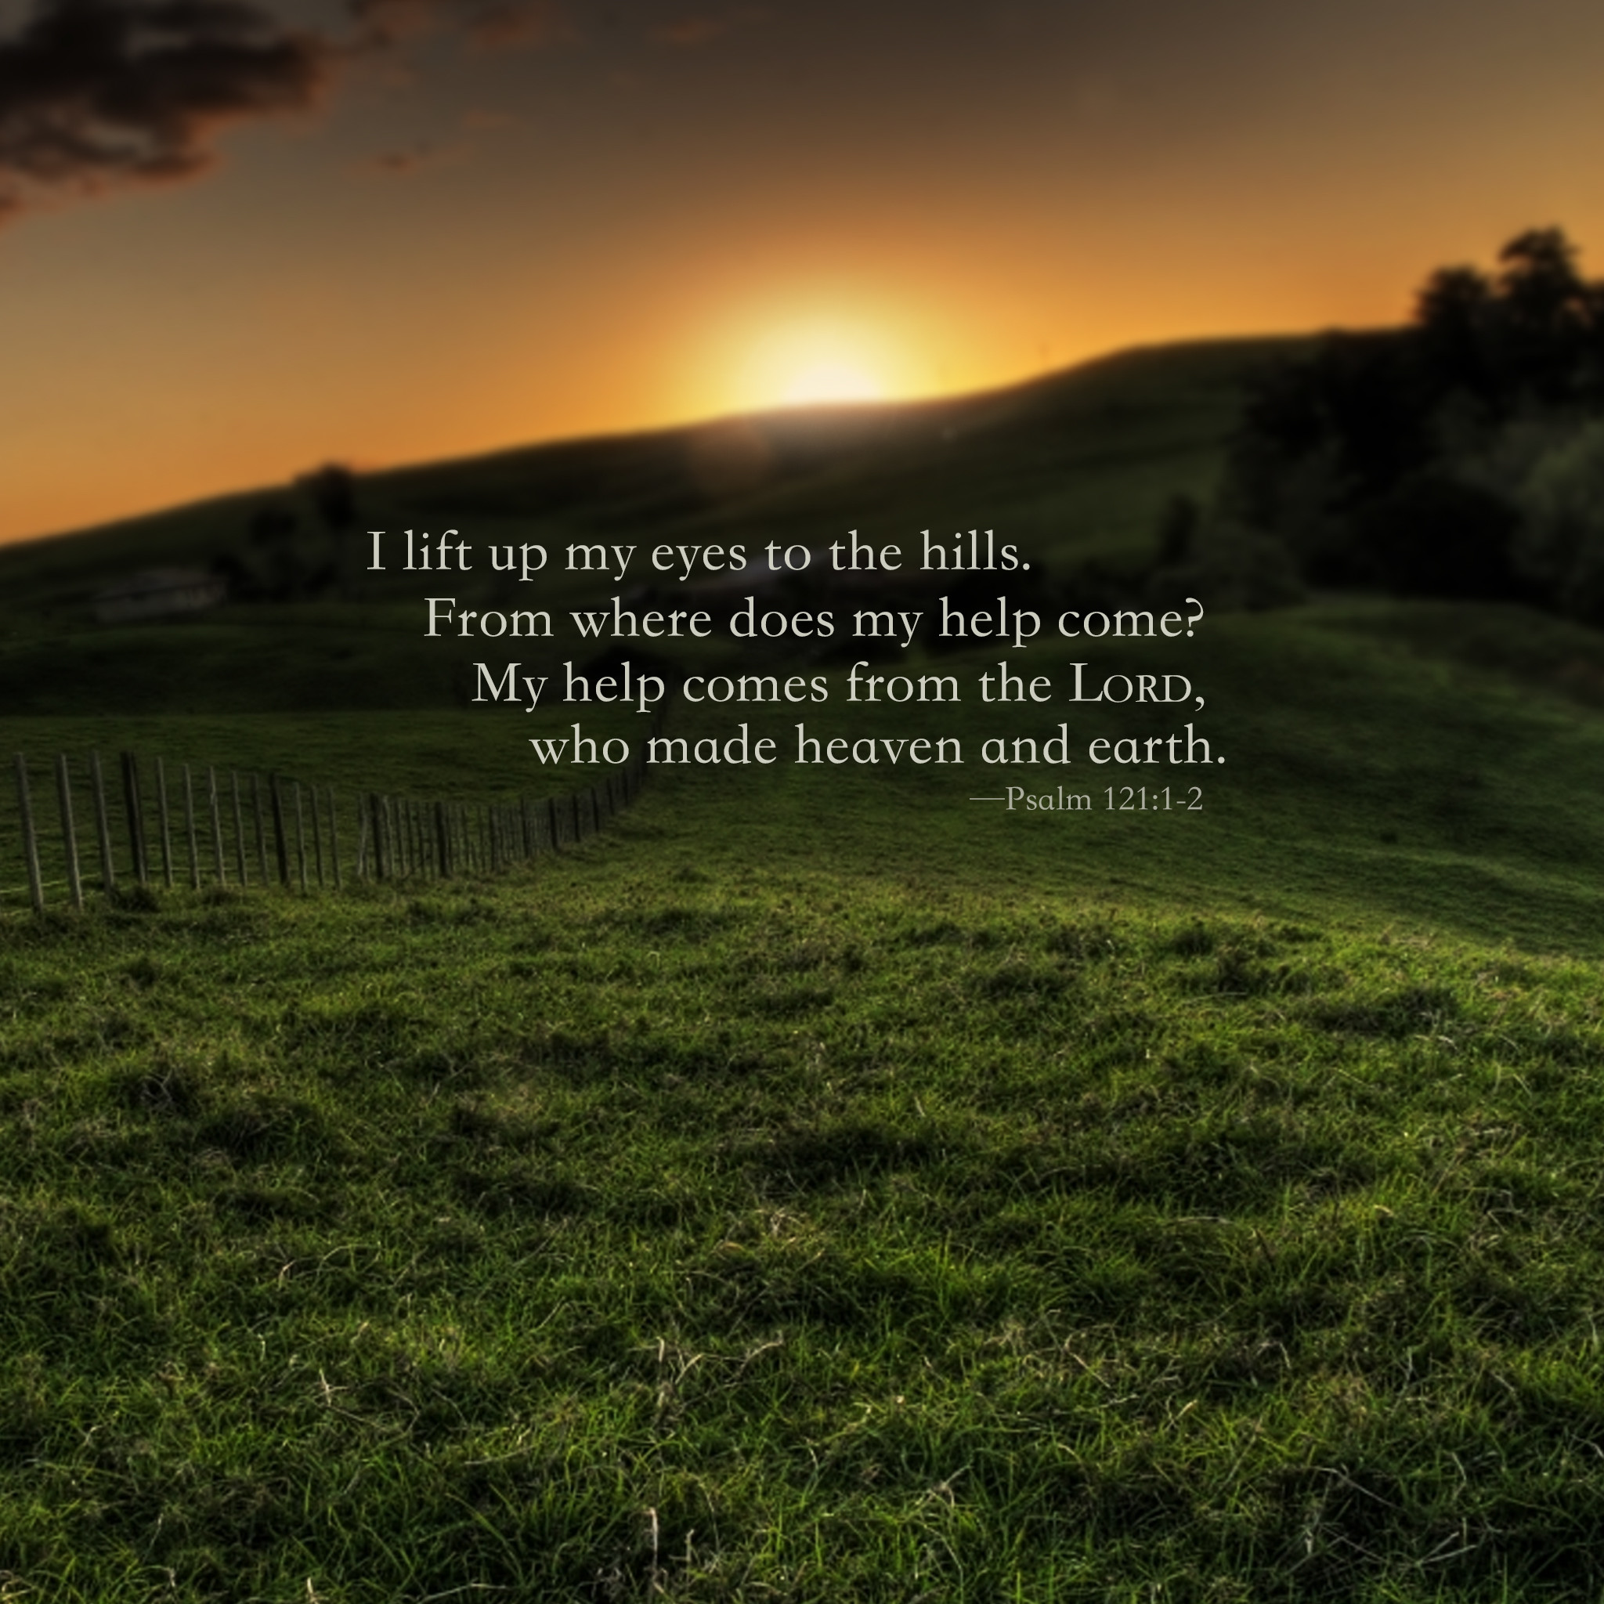
CLOSING PRAYER -6
Awesome Creator, You are the Good Shepherd, in You we lack nothing.
Thank You for blessing Your people because just as You draw the sheep near to green pastures and still waters, You refresh and uplift the souls of Your people.
We know that You will guide us along the right paths for Your Name’s sake. Even when we walk through the darkest valleys, we will fear no evil, for You are with us always; Your rod and Your staff will uplift, comfort and bless us and for this assurance and grace we give You praise. Thank you, Father. Amen. Psalm 23:1-4
Know that the Lord has set apart His faithful servants for himself; the Lord hears when we call to Him.” – Psalm 4:3
Notes:
One prays this prayer on behalf of all.
Once again, everyone gives thanks for the exceedingly great and precious promises of God.

Slide 40
Kislev 5783 Nov 25-Dec 24
Physical Year Month: 3 = Camel, Provision, Lifted Up, Divine fullness, Trinity
Spiritual Year Month: 9 = Choice of Life or Death Chanukah Begins- Feast of Dedication (Feast of Lights)
Fall Season – Season of Repentance
Monthly theme: Security/Hope, Trust, and Restful sleep.
Hebrew Tribe: Benjamin (Identity change: Named by mother Rachel for her pain; renamed by father “Son of my right hand”). Peaceful, but strong, warriors.
Hebrew letter- Samekh…Value = 60 Priestly blessing. Letter looks
like a circle--To trust, support; to come full circle.
Characteristics—
Second chances at missed opportunities.
Also, a lattice– to lean upon, uphold, prop. As lattices
support grapevines in a vineyard.
Month of hope; month of dreams
Month to watch Israel (and to watch over Israel)
Shortest (darkest) day of the year—shine your light brighter.
Celebration of the lights (Chanukah) the light of His Mercies
never goes out. His mercies reign in the midst of destruction.
Constellation – SAGITARIUS, the Archer (Shoot straight, move
quickly, cut your losses and move on) Pull bow back with the
strong arm of the Lord. Dress in spiritual armor and stand strong.
Action - Sleeping (and Dreaming)
Body part- Stomach
Colors/Gemstone: Multicolored or Rainbow colored (Opal)
https://www.christinevales.com/

