Slide 2
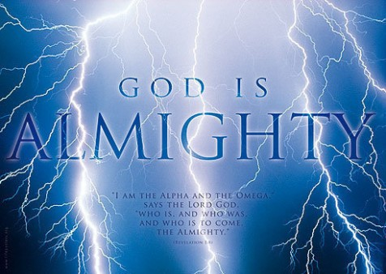
PRAISE
&
WORSHIP

Slide 3
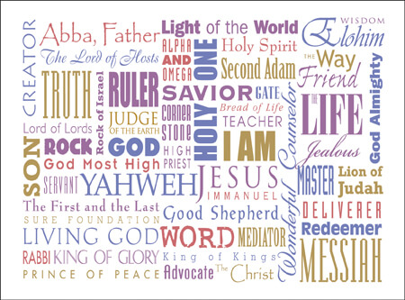
PRAISE
&
WORSHIP

Slide 4
PRAISE
&
WORSHIP

Slide 5
PRAISE
&
WORSHIP

Slide 6
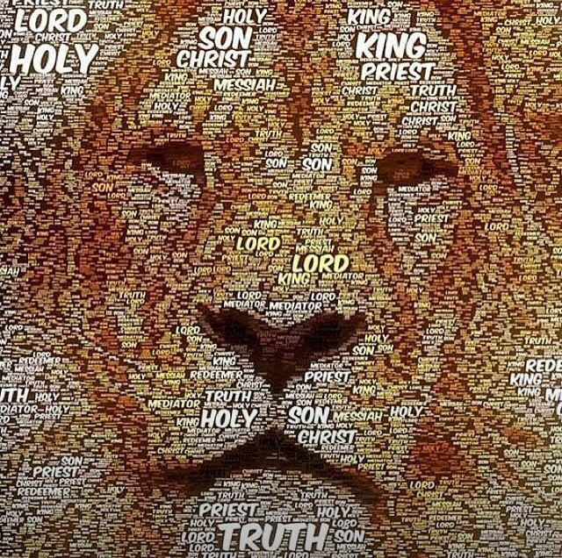
Almighty God,
We Worship YOU!

Slide 7
PRAISE
&
WORSHIP

Slide 9
PRAISE
&
WORSHIP

Slide 11
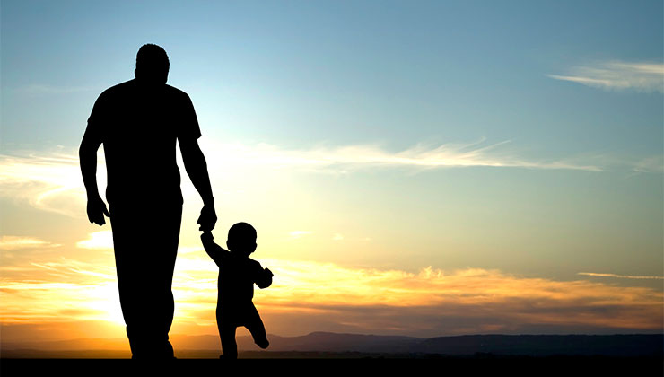
TRANSCENDENT MAJESTY Elohim (God) El Elyon (The Most High God) El Shaddai (Lord God Almighty) El Olam (The Everlasting God) El Roi (God Sees me) Yahweh (Lord, Jehovah) Adonai (Lord, Master) El Qanna (Jealous God) Jehovah Sabaoth (The Lord of Hosts) Jehovah Nissi (The Lord Is My Victory Banner) | HEAVENLY FATHER Abba Jehovah Jireh (The Lord Will Provide) Jehovah Rapha (The Lord Who Heals You) Jehovah Mekoddishkem (The Lord Who Sanctifies You) Jehovah Shalom (The Lord Is Peace) Jehovah Raah (The Lord Is My Shepherd) Jehovah Tsidkenu (The Lord Our Righteousness) Jehovah Shammah (The Lord Is There) LOVE

Slide 12
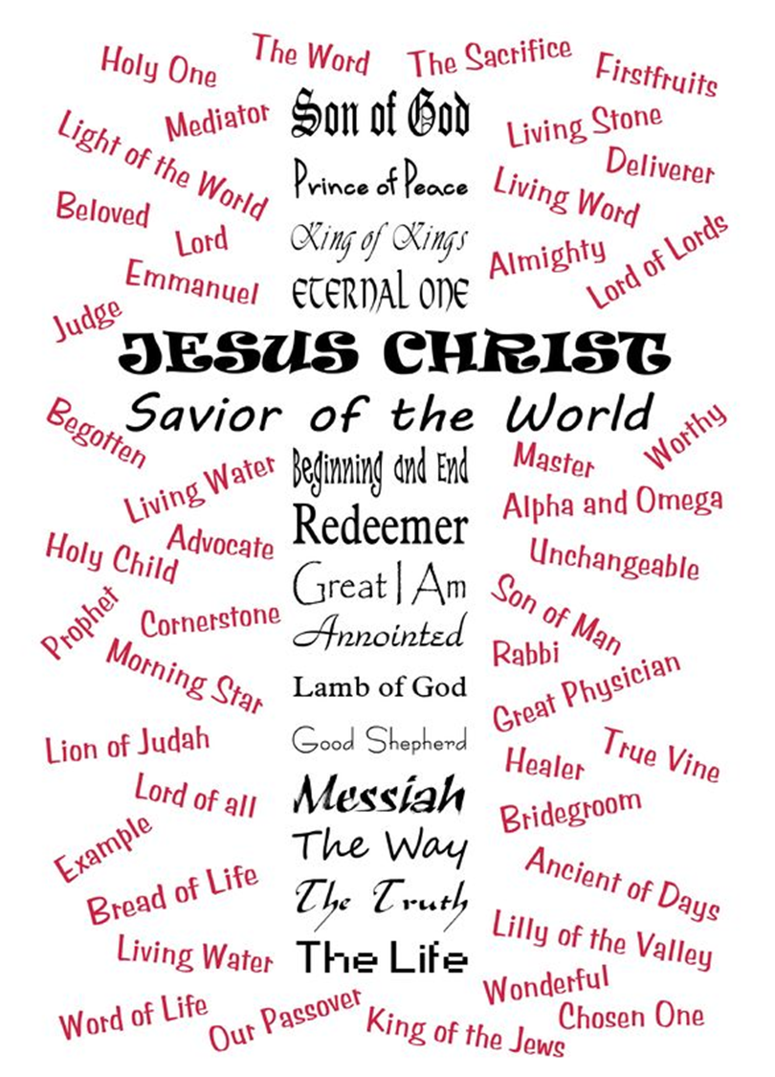

Slide 13
JESUS
Jesus is the Lamb of God who takes away the sins of the world.
His blood redeems us.
By His blood judgment is turned away and we are reconciled to God.
1. By His blood the power of the enemy is broken forever.
2. By His blood we are released from bondage and oppression.
3. By His blood we are set free to enter into His promises and fulfill our destinies.
1. By His blood we have abundant life now and eternal life forever.

Slide 14
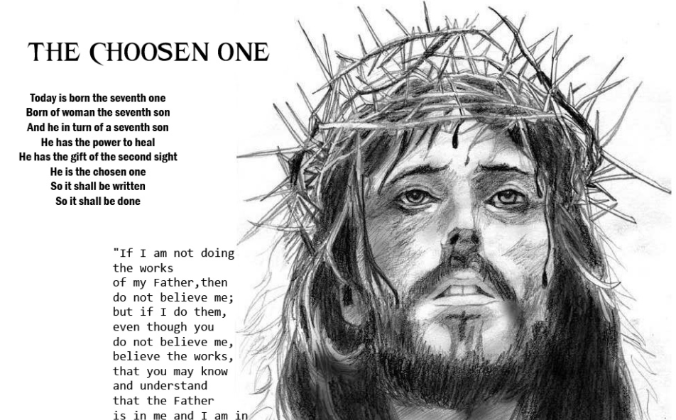
THE CHOSEN ONE
…But he was pierced for our transgressions, He was crushed for our iniquities; the punishment that brought us peace was on Him, and by his wounds we are healed.
We all, like sheep, have gone astray, each of us has turned to our own way; and the Lord has laid on Him the iniquity of us all.
He was oppressed and afflicted, yet He did not open his mouth; He was led like a lamb to the slaughter, and as a sheep before its shearers is silent, so He did not open his mouth.
Therefore I will give him a portion among the great, and He will divide the spoils with the strong, because He poured out his life unto death, and was numbered with the transgressors. For He bore the sin of many, and made intercession for the transgressors.

Slide 15
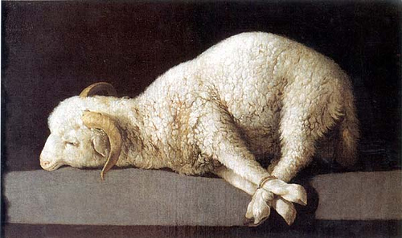
JESUS, SON of GOD!
Master
Savior
Prince of Peace
Good Shepherd
Friend of Sinners
Son of God
Bridegroom
Lover of our souls
King of Kings
Soon Coming King
Commander of Heaven’s Armies
Lily of the Valley
Wonderful Counselor
Way Maker
All Sufficiency
And they sang a new song, saying:
“You are worthy to take the scroll, And to open its seals; For You were slain, And have redeemed us to God, by Your blood, out of every tribe and tongue and people and nation, and have made us kings and priests to our God; And we shall reign on the earth.”
Rev 5:9

Slide 16
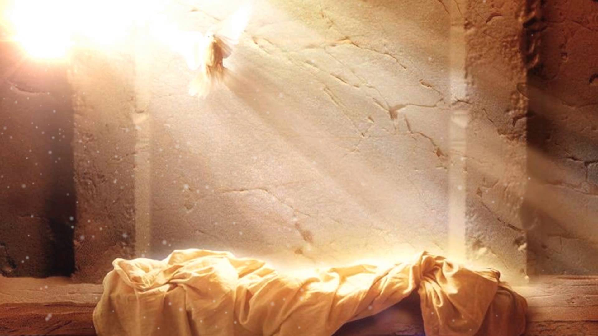
Jesus, the Resurrected Lord
…that the God of our Lord Jesus Christ, the Father of glory, may give to (all believers) the spirit of wisdom and revelation in the knowledge of Him, the eyes of our understanding being enlightened; that we may know what is the hope of His calling, what are the riches of the glory of His inheritance in the saints, and what is the exceeding greatness of His power toward us who believe,
according to the working of His mighty power which He worked in Christ when He raised Him from the dead and seated Him at His right hand in the heavenly places, far above all principality and power and might and dominion, and every name that is named, not only in this age but also in that which is to come.
And He put all things under His feet, and gave Him to be head over all things to us, the Church, which is His body, the fullness of Him who fills all in all.

Slide 17
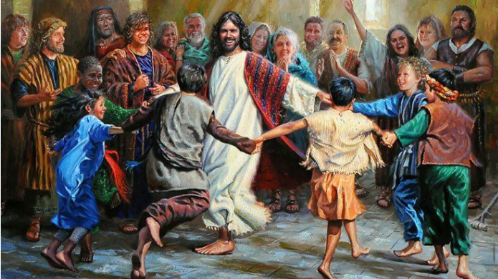
Jesus, Friend of All
Turn your eyes upon Jesus, Look full in His wonderful face And the things of earth will grow strangely dim in the light of His glory and grace.
Oh soul are you weary and troubled? No light in the darkness you see? There's light for a look at the Savior and life more abundant and free.
Through death into life everlasting He passed and we follow Him there. Over us sin no more has dominion for more
than conquerors we are.
4. His Word shall not fail you, He promised.
Believe Him and all will be well. Then go to a world that is dying
His perfect salvation to tell!

Slide 18
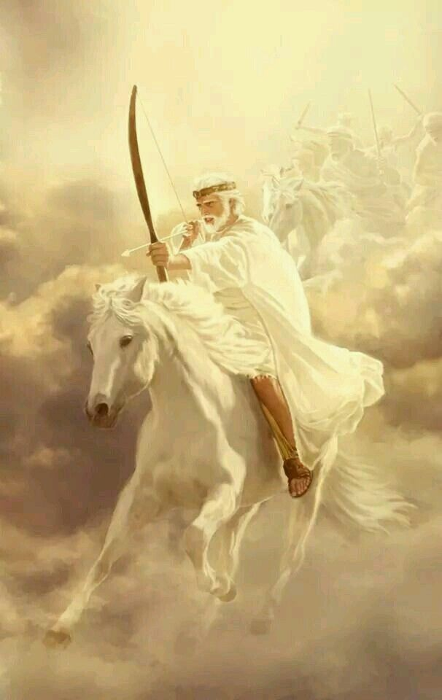
JESUS, Our Conquering King
A mighty fortress is our God, A bulwark never failing: Our helper He, amid the flood of mortal ills prevailing. For still our ancient foe does seek to work his woe; His craft and power are great, and armed with cruel hate, on earth he has no equal
Did we in our own strength confide, our striving would be losing; Were not the right Man on our side, the Man of God's own choosing. Do you ask who that may be? Christ Jesus, it is He; Lord Sabaoth- His name, from age to age the same, and He must win the battle.
And though this world, with devils filled, should threaten to undo us, we will not fear, for God has willed His Truth to triumph through us. The Prince of Darkness grim,— we tremble not for him; His rage we can endure, for lo! his doom is sure,— one little word shall fell him.
That Word above all earthly powers— no thanks to them—abides. The Spirit and the gifts are ours through Him who with us sides. Let goods and kindred go, this mortal life also. The body they may kill; God's truth abides still, Christ’s kingdom is for ever.

Slide 19
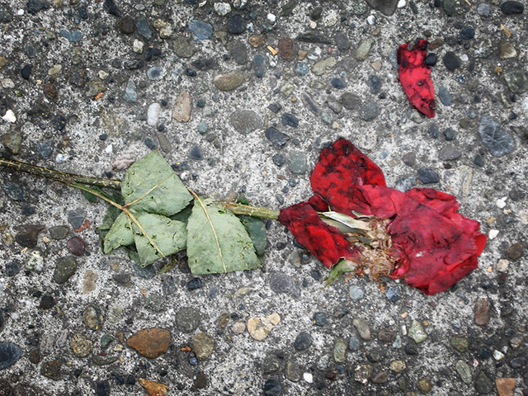
Jesus, Lover of My Soul

Slide 20
Jesus, Soon Coming King
And the Holy Spirit also testifies that this is so. For He says, “This is the new covenant I will make with my people on that day, says the Lord: I will put my laws in their hearts, and I will write them on their minds.” Then He says, “I will never again remember their sins and lawless deeds.” And when sins have been forgiven, there is no need to offer any more sacrifices.
And so, dear brothers and sisters, we can boldly enter heaven’s Most Holy Place because of the blood of Jesus. By His death, Jesus opened a new and life-giving way through the curtain into the Most Holy Place. And since we have a great High Priest who rules over God’s house, let us go right into the presence of God with sincere hearts fully trusting Him. For our guilty consciences have been sprinkled with Christ’s blood to make us clean, and our bodies have been washed with pure water.
Let us hold tightly without wavering to the hope we affirm, for God can be trusted to keep His promise. Let us think of ways to motivate one another to acts of love and good works. And let us not neglect our meeting together, as some people do, but encourage one another, especially now that the day of his return is drawing near.
1. So do not throw away this confident trust in the Lord. Remember the great reward it brings you! Patient endurance is what you need now, so that you will continue to do God’s will. Then you will receive all that He has promised.
2. “For in just a little while, the Coming One will come and not delay. And my righteous ones will live by faith. But I will take no pleasure in anyone who turns away.” But we are not like those who turn away from God to their own destruction. We are the faithful ones, whose souls will be saved. Hebrews 10

Slide 21
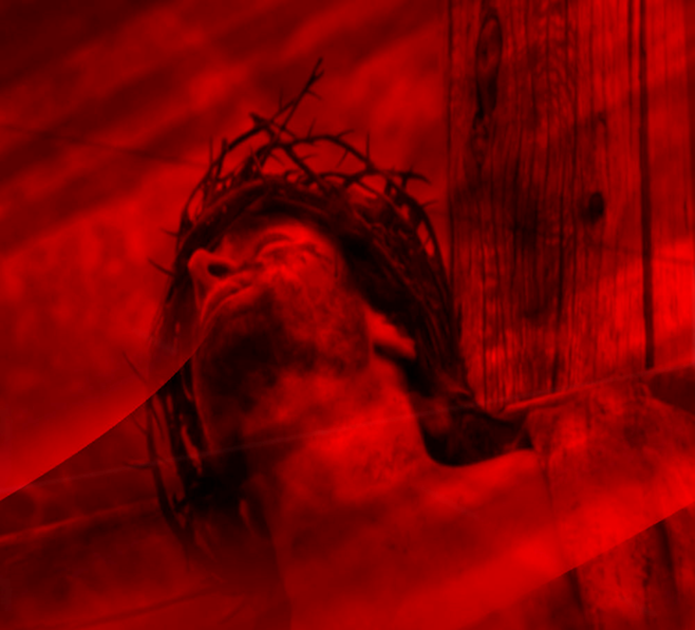
Jesus, our Savior
…But he was pierced for our transgressions, He was crushed for our iniquities; the punishment that brought us peace was on Him, and by his wounds we are healed.
We all, like sheep, have gone astray, each of us has turned to our own way; and the Lord has laid on Him the iniquity of us all.
He was oppressed and afflicted, yet he did not open his mouth; He was led like a lamb to the slaughter, and as a sheep before its shearers is silent, so He did not open his mouth.
1. By oppression and judgment He was taken away. Yet who of his generation protested?
2. For He was cut off from the land of the living; for the transgression of my people He was punished. He was assigned a grave with the wicked, and with the rich in His death, though He had done no violence, nor was any deceit in His mouth.
3. Therefore I will give him a portion among the great, and He will divide the spoils with the strong, because He poured out his life unto death, and was numbered with the transgressors. For he bore the sin of many, and made intercession for the transgressors.

Slide 22
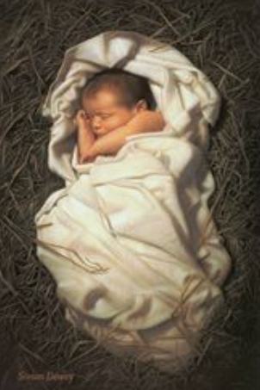
JESUS, Son of Man
For unto us a Child is born, unto us a Son is given; and the government will be upon His shoulder.
And His name will be called Wonderful, Counselor, Mighty God, Everlasting Father, Prince of Peace.
Of the increase of His government and peace There will be no end, upon the throne of David and over His kingdom, to order it and establish it with judgment and justice from that time forward, even forever.
The zeal of the Lord of hosts will perform this. Isaiah 9:6

Slide 23
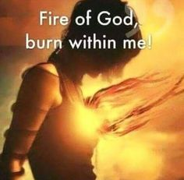
Holy Spirit, be welcome in this place!
Spirit of the living God, Fall afresh on me. Melt me, mold me, fill me, use me. Spirit of the living God, Rise up afresh in me.
Each intercessor makes this PERSONAL declaration, pulling the Holy Spirit into the atmosphere and releasing into the territory.

Slide 24
“And I will ask the Father, and He will give you another Advocate, who will never leave you. He is the Holy Spirit, who leads into all truth. The world cannot receive Him, because it isn’t looking for Him and doesn’t recognize Him. But you know Him, because He lives with you now and later will be in you. No, I will not abandon you as orphans—I will come to you. Soon the world will no longer see Me, but you will see Me. Since I live, you also will live.” John 14:16-19
Spirit of the living God, Fall afresh on me. Melt me, mold me, fill me, use me. Spirit of the living God, Rise up afresh in me.
Each intercessor makes this PERSONAL declaration, pulling the Holy Spirit into the atmosphere and releasing into the territory.

Slide 25
Be Welcome here, Holy Spirit!
Spirit of the living God, Fall afresh on me. Melt me, mold me, fill me, use me. Spirit of the living God, Rise up afresh in me.
Each intercessor makes this PERSONAL declaration, pulling the Holy Spirit into the atmosphere and releasing into the territory.

Slide 26
These things I have spoken to you while being present with you.
But the Helper, the Holy Spirit, whom the Father will send in My name,
He will teach you all things, and bring to your remembrance all things that I said to you.
John 14:25-26
Spirit of the living God, Fall afresh on me. Melt me, mold me, fill me, use me. Spirit of the living God, Rise up afresh in me.

Slide 27
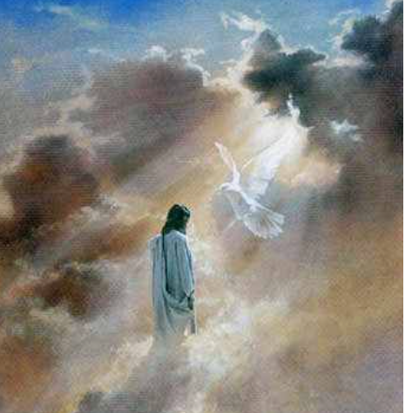
Step into His Presence
Breathe on us, Breath of God, fill us with life anew, That we may love just as You love, and do what You would do.
Breathe on us, Breath of God, until our heart is pure, Until with You, we will One Will, to do and to endure.
Breathe on us, Breath of God, ‘til we are wholly Thine, Until this earthly part of us glows with Your fire divine.
Again He said, “Peace be with you. As the Father has sent me, so I am sending you.” Then he breathed on them and said, “Receive the Holy Spirit.” John 20:21-22
Notes:
(Breathe on Me Breath of God)

Slide 28
Holy Spirit, be welcome in this place!
God of Elijah, hear our cry: Send the fire!
To make us fit to live or die, Send the fire!
To burn up every trace of sin, To bring the light and glory in, The revolution now begin, Send the fire!
Each intercessor makes this PERSONAL declaration, pulling the Holy Spirit into the atmosphere and releasing into the territory.

Slide 30
Spirit of the living God, Fall afresh on me. Melt me, mold me, fill me, use me. Spirit of the living God, Rise up afresh in me.
And the disciples were filled with joy and with the Holy Spirit. Acts 13:52

Slide 31
Holy Spirit….Who He Is!
Breath of The Almighty The Holy Spirit is the life-giving breath of God! Job 33:4
Counselor & Comforter The Holy Spirit is our comforter, our counselor and He gives us strength! John 14:16,26; 15:26; Romans 8:26
Spirit of Counsel The Holy Spirit will counsel us and teach us as we grow in Christ! Isaiah 11:2
Eternal Spirit The Holy Spirit is the eternal God! Hebrews 9:14
Free Spirit The Holy Spirit is a generous and willing spirit! Psalm 51:12
God The Holy Spirit is God as the Third Person of the Trinity! Acts 5:3-4
Good Spirit God’s Spirit will teach us and lead us in goodness! Nehemiah 9:20; Psalm 143:10
Holy Spirit God is the Spirit and He is Holy! He is the Spirit of Holiness. Psalm 51:11, Luke 11:13, Ephesians 1:13, 4:30
Lord As the Third Person in the Trinity, the Holy Spirit is recognized and worshiped as the Lord! 2 Corinthians 3:16-17
Power of the Highest The Spirit of God’s Power, He is the greatest power! Luke 1:35
Spirit of Might Isaiah 11:2
He is the Spirit of strength.
Spirit of Adoption Romans 8:15
By this Spirit we are made heirs of God
Spirit of Burning Isaiah 4:4
He is the fire of purification!
Spirit of Judgment Isaiah 4:4, 28:6
The Spirit brings conviction and judgment.
Spirit of Christ (Jesus Christ) Romans 8:9, 1 Peter 1:11
The Holy Spirit is the Spirit shared between Jesus and God
Spirit of Glory 1 Peter 4:14
The Holy Spirit always gives Glory to God!
Spirit of God Genesis 1:2, 1 Corinthians 2:11, Job 33:4
The Holy Spirit is the Spirit of the Triune God!
Spirit of the Lord Yahweh Isaiah 11:2, Isaiah 61:1
The Spirit has the sacred name for God-Yahweh!
Spirit of Grace Zechariah 12:10, Hebrews 10:29
He is a Spirit of Grace!
Spirit of Knowledge Isaiah 11:2
The Holy Spirit has clarity of Mind.
Spirit of Truth John 14:17, 15:26
The Holy Spirit is about truth not falsehood!
Spirit of Life Romans 8:2
The Holy Spirit gives life!
Spirit of Understanding Isaiah 11:2
The Holy Spirit is understanding!
Spirit of Wisdom Isaiah 11:2, Ephesians 1:17
The Holy Spirit is wise!
Spirit of the Living God 2 Corinthians 3:3
The Holy Spirit is the Spirit of the One True God who is the God of Life!
Spirit of Prophecy Revelation 19:10
The Holy Spirit inspires true prophecy!
Spirit of the Father Matthew 10:20
The Holy Spirit is shared between the Father and the Son.
Spirit of the Fear of the Lord Isaiah 11;2
The Spirit of the Spirit of reverence toward our God.
Spirit of the Lord (God) Acts 5:9
The Holy Spirit is the presence of the Lord.
Spirit of the Son Galatians 4:6
The Holy Spirit shared between the Son and the Father.
Spirit Matthew 4:1, John 3:6, 1 Timothy 4;1
Sometimes simply referenced as the “Spirit”.
Spirit of Revelation Ephesians 1:17
God reveals His truth through the Holy Spirit!

Slide 32
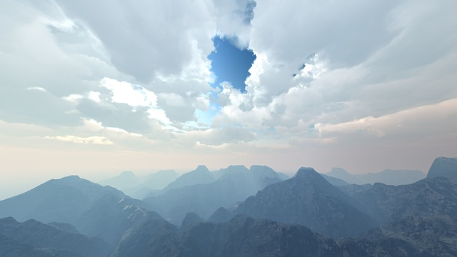
The FEAR of the LORD…
If you fear the Lord and serve Him and obey His voice, and do not rebel against the commandment of the Lord, then both you and the king who reigns over you will continue following the Lord your God. “Now therefore, fear the Lord, serve Him in sincerity and in truth, and put away the gods which your fathers served on the other side of the River and in Egypt. Serve the Lord! Then the churches throughout all Judea, Galilee, and Samaria had peace and were edified. And walking in the fear of the Lord and in the comfort of the Holy Spirit, they were multiplied. Acts 9:31 This became known both to all Jews and Greeks dwelling in Ephesus; and fear fell on them all, and the name of the Lord Jesus was magnified. Acts 19:17 “Do not say, ‘A conspiracy,’ concerning all that this people call a conspiracy, nor be afraid of their threats, nor be troubled. The Lord of hosts, Him you shall hallow; Let Him be your fear, and let Him be your dread. He will be as a sanctuary, but a stone of stumbling and a rock of offense to both the houses of Israel, Is 8:12-14 The fear of the Lord is the beginning of knowledge, But fools despise wisdom and instruction. Prov 1:7 The fear of the Lord prolongs days, but the years of the wicked will be shortened. In the fear of the Lord there is strong confidence, And His children will have a place of refuge. Prov 14:26

Slide 33
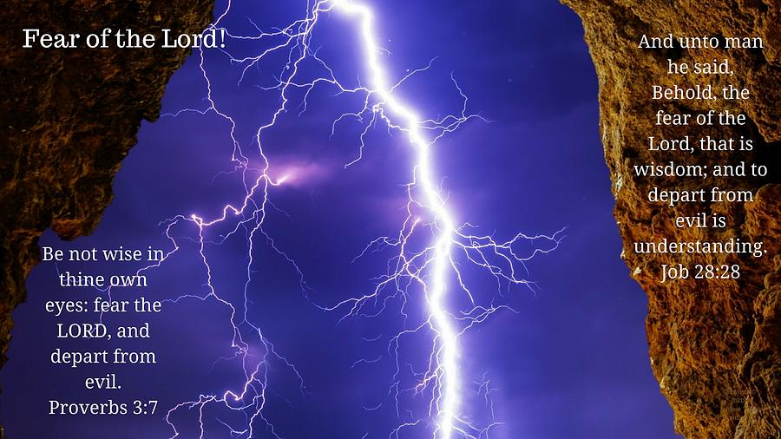

Slide 34
LOVE is patient, LOVE is kind. LOVE does not envy, it does not boast, it is not proud.
LOVE does not dishonor others, LOVE is not self-seeking, it is not easily angered, LOVE keeps no record of wrongs.
LOVE does not delight in evil but rejoices with the truth.
LOVE always protects, always trusts, always hopes, always perseveres.
LOVE never fails.

Slide 36
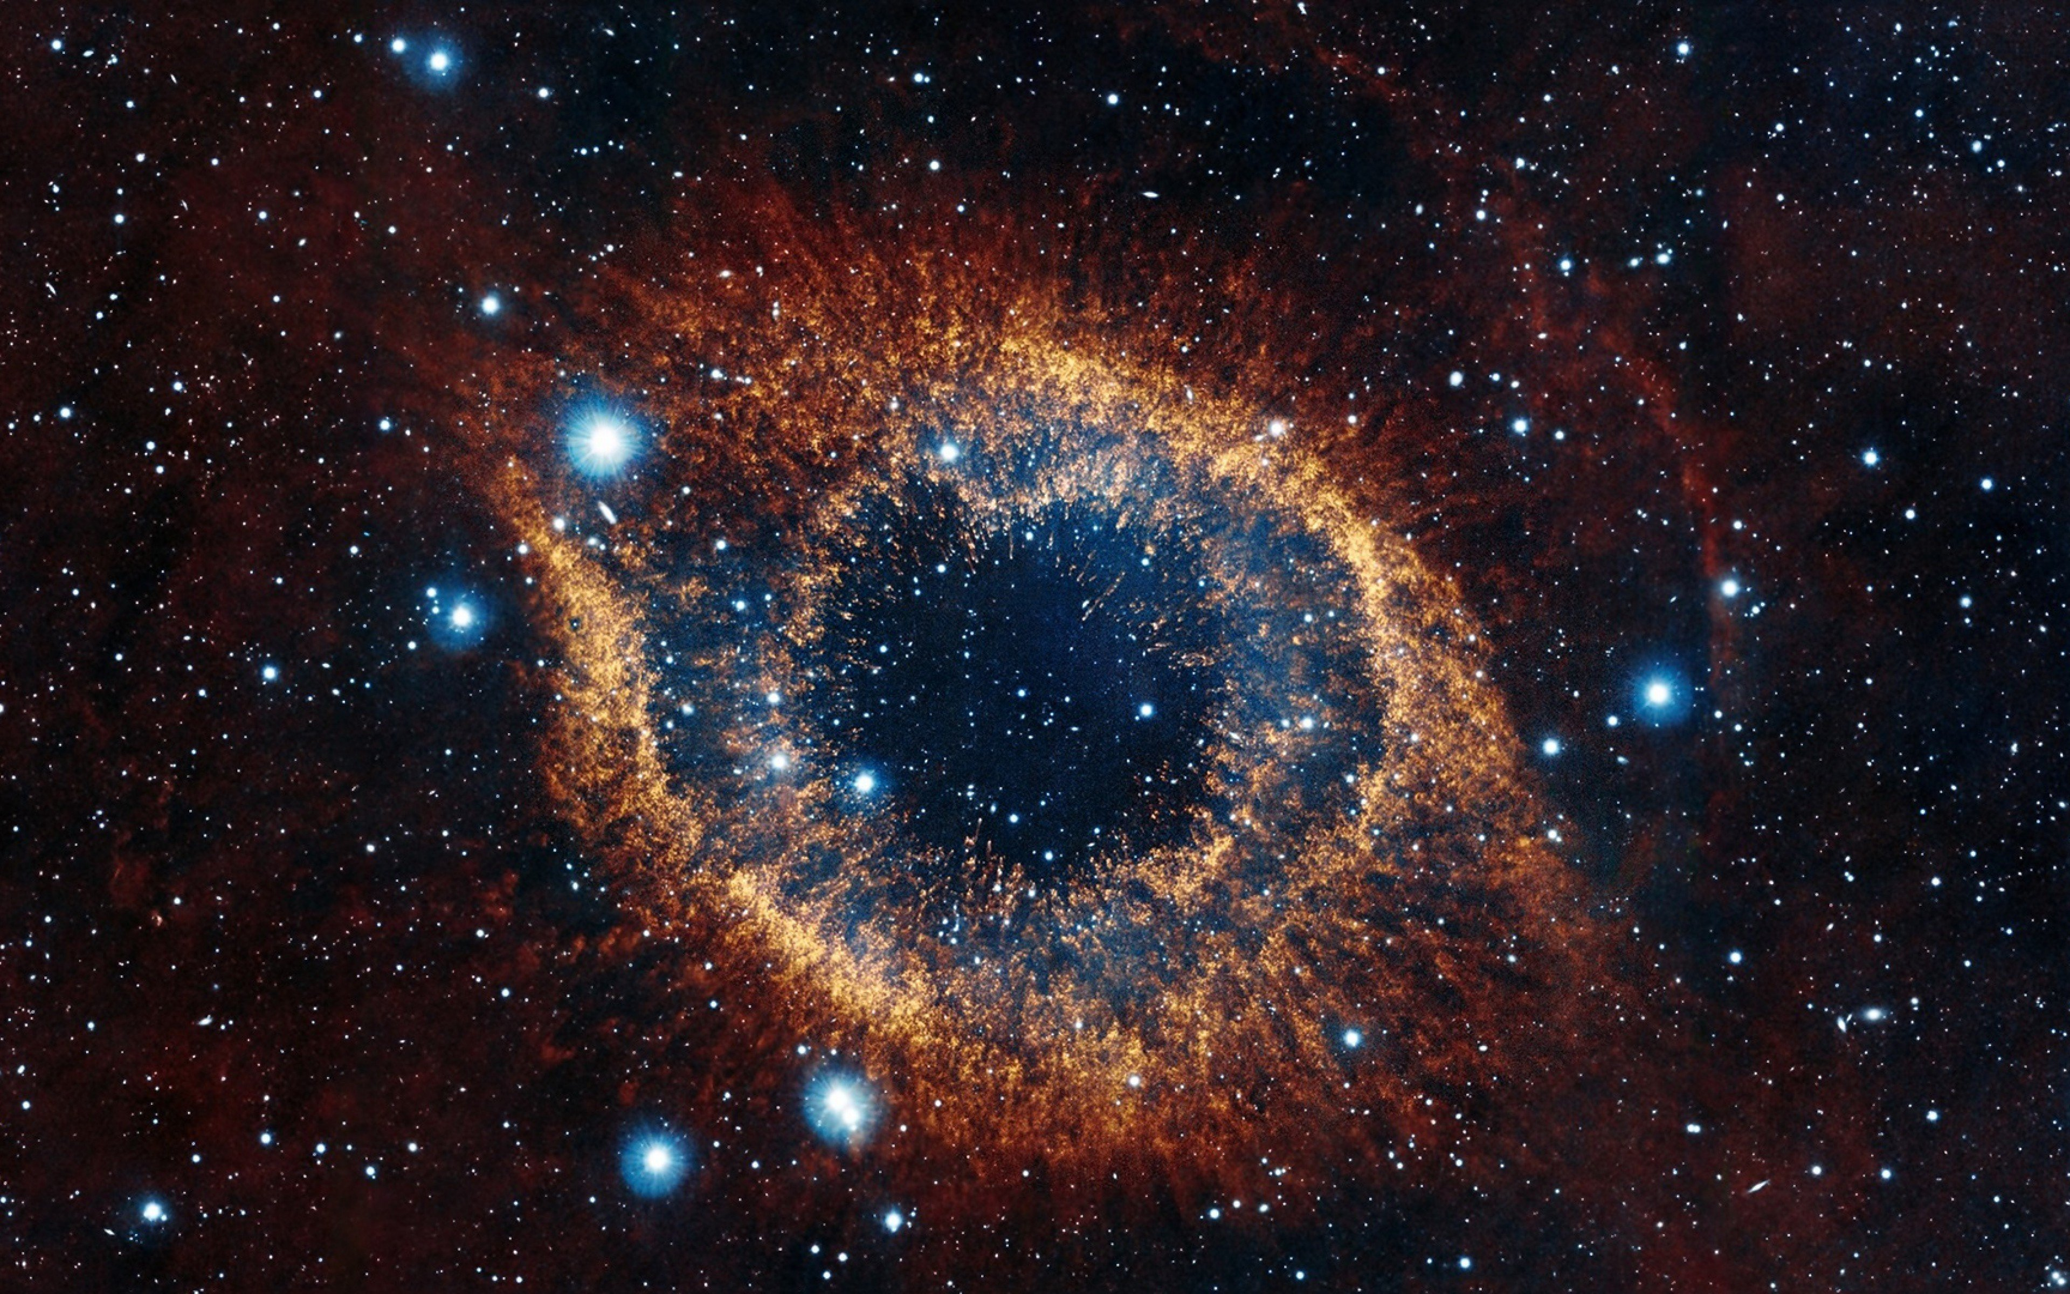

Slide 37
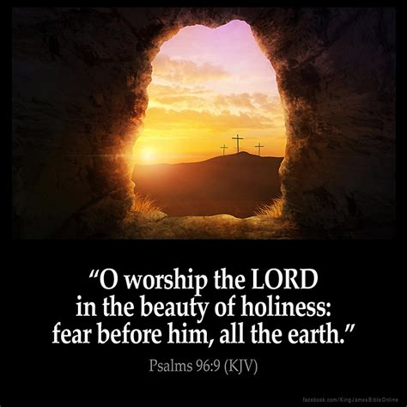

Slide 38
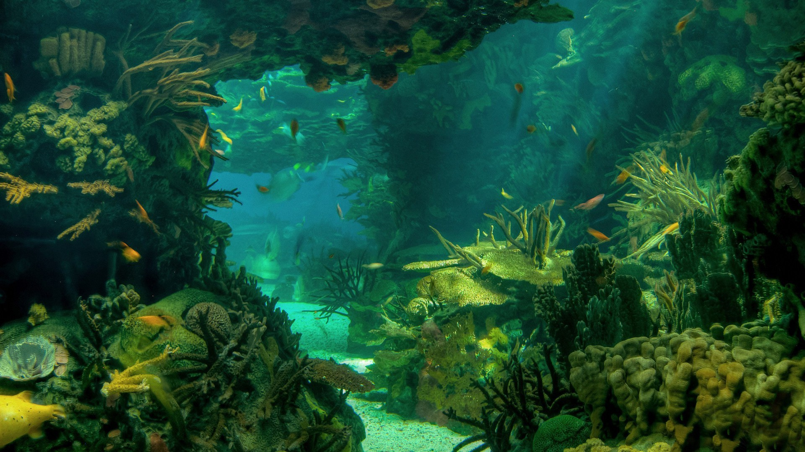
Where can I go from your Spirit? Where can I flee from your presence? If I go up to the heavens, you are there; if I make my bed in the depths, you are there.
If I rise on the wings of the dawn, if I settle on the far side of the sea, even there your hand will guide me, your right hand will hold me fast.
If I say, “Surely the darkness will hide me and the light become night around me,” even the darkness will not be dark to you; the night will shine like the day, for darkness is as light to you.
FEAR THE LORD

Slide 39
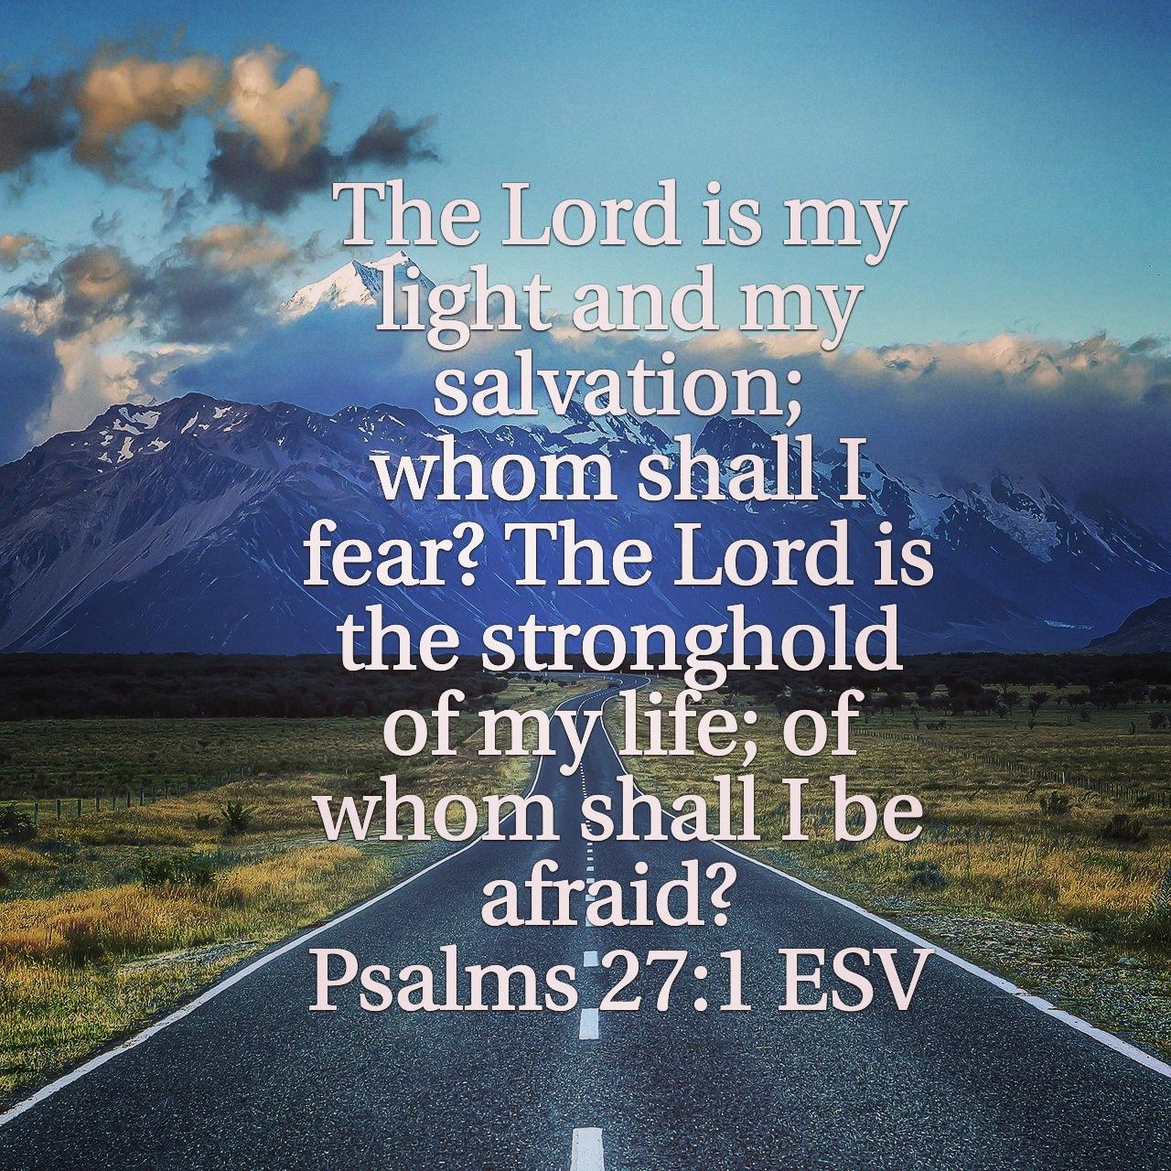
You alone will we fear, Almighty God

Slide 40
We yield our tongues to You, Holy Spirit.

Slide 41
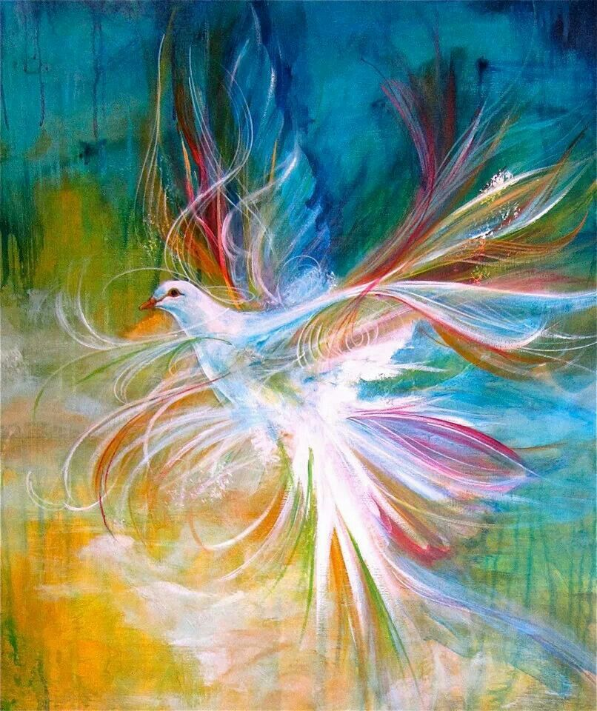
We yield our tongues to You, Holy Spirit.

Slide 42
We Yield Our Tongues to You!

Slide 43
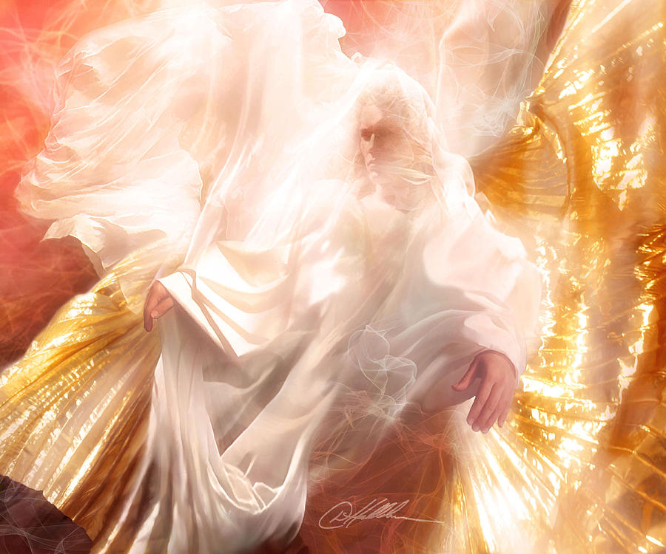
We yield our tongues to You, Holy Spirit.

Slide 44
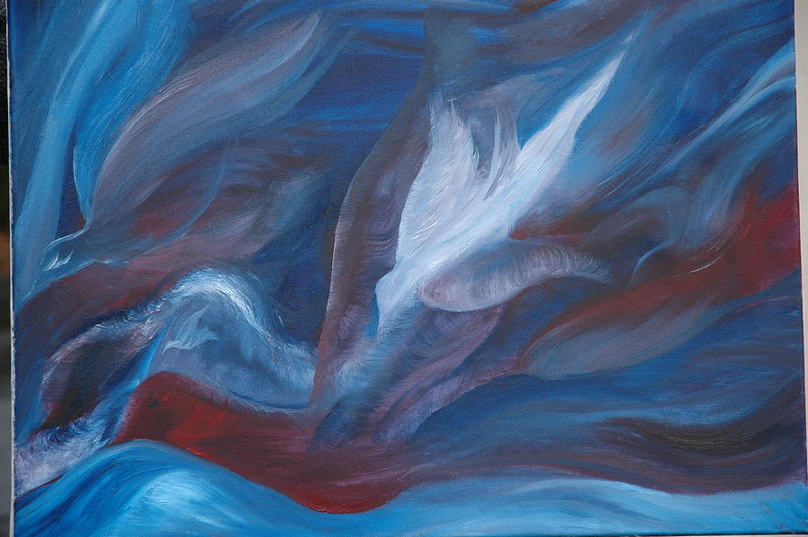
We yield our tongues to You, Holy Spirit.

Slide 45
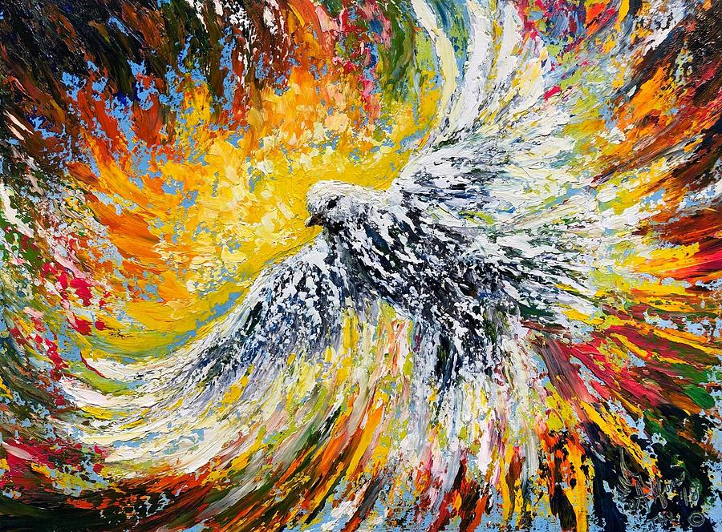
We Yield Our Tongues to You!

Slide 46
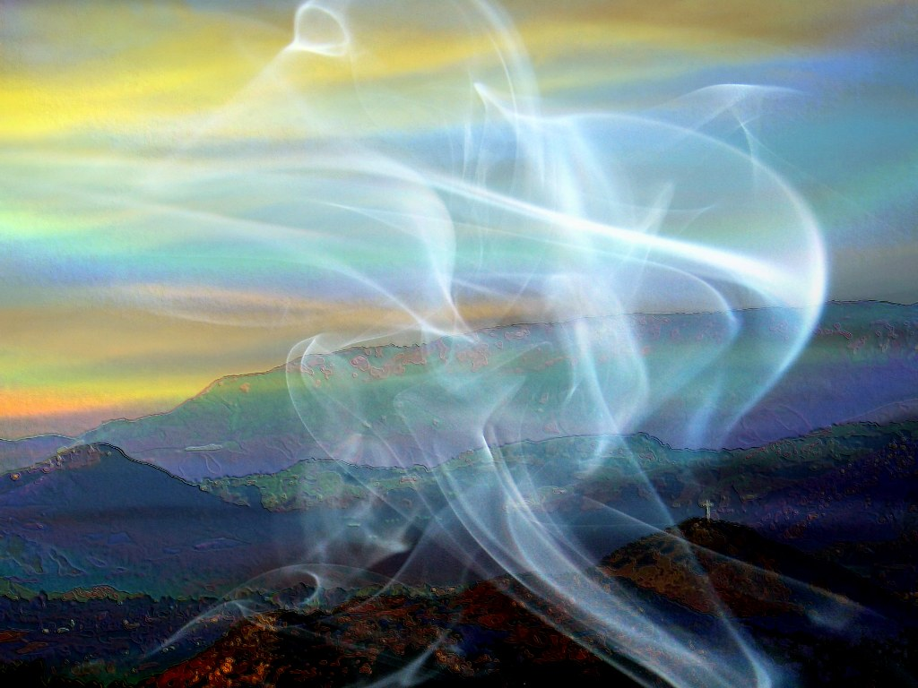
We yield our tongues to You, Holy Spirit.
This Photo by Unknown Author is licensed under CC BY-ND

