Slide 1
INTERCESSORY PRAYER
The APOSTOLIC KINGDOM EKKLESIA
SUNCOAST Hub

Slide 2
Focus: RELIGION…HEALTH…FAITH
SUNDAY
Awaken the Dawn
Morning Prayer Hour

Slide 3
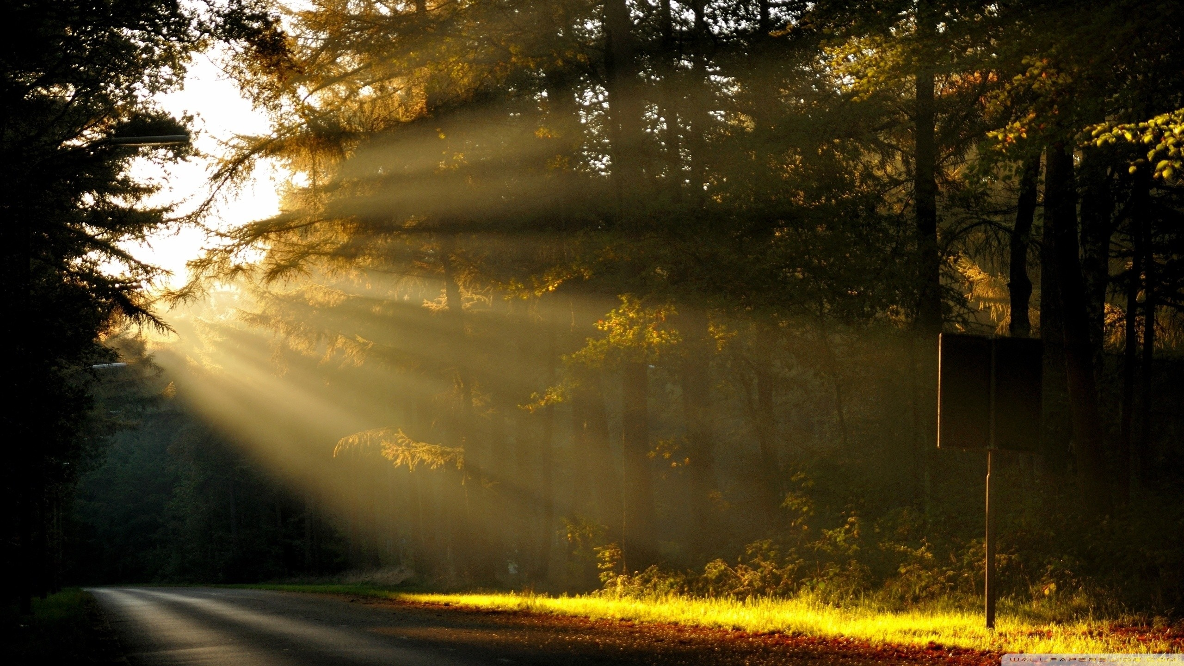
MONDAY
AWAKEN THE DAWN Morning Prayer Hour
Focus: BUSINESS…WISDOM…PEACE

Slide 4
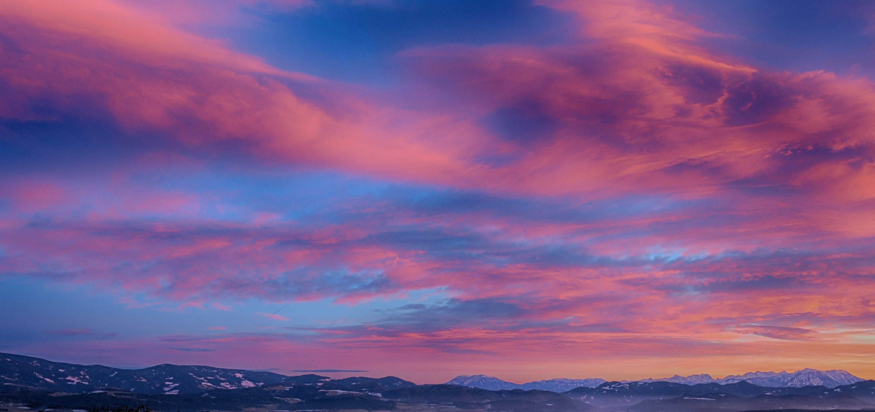
Focus: EDUCATION…PROTECTION…KINDNESS
TUESDAY
Awaken the Dawn
Morning Prayer Hour

Slide 5
Focus: ARTS & ENTERTAINMENT…PROSPERITY…JOY…
Wednesday
Awaken the Dawn
Morning Prayer Hour

Slide 6
Thursday
Awaken the Dawn
Morning Prayer Hour
Focus on: GOVERNMENT…PROVISION…PERSEVERANCE

Slide 7
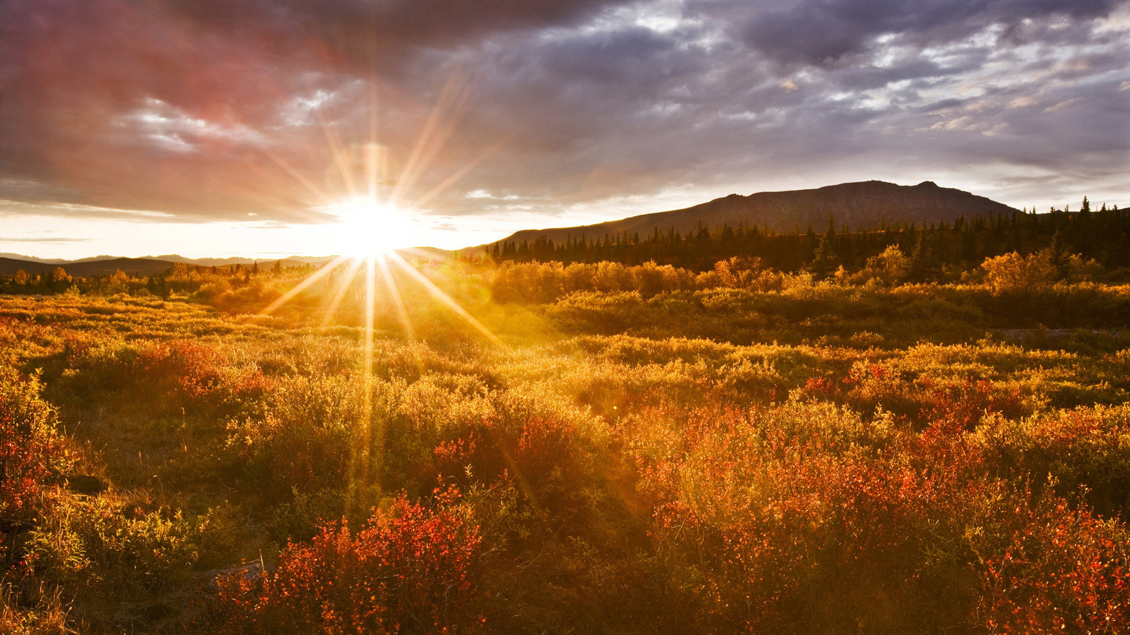
Focus on: FAMILY…TRUST…LOVE…
Friday
AWAKEN THE DAWN
Morning Prayer Call

Slide 8
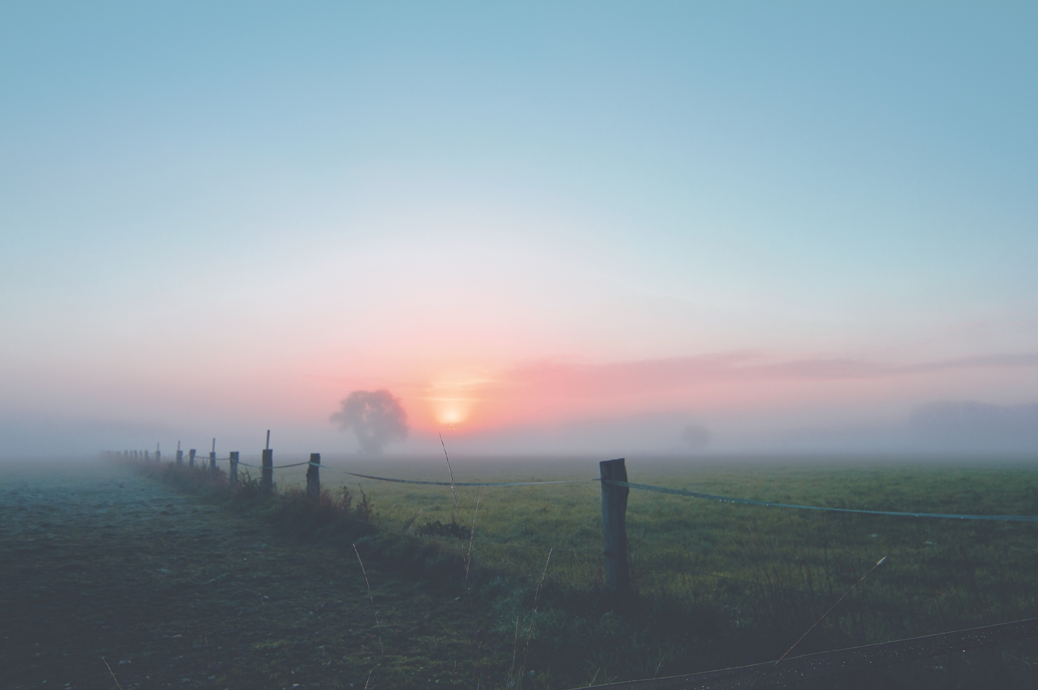
Focus on: MEDIA…TECHNOLOGY…BLESSING…PATIENCE
SATURDAY
Awaken the Dawn
Morning Prayer Hour

Slide 9
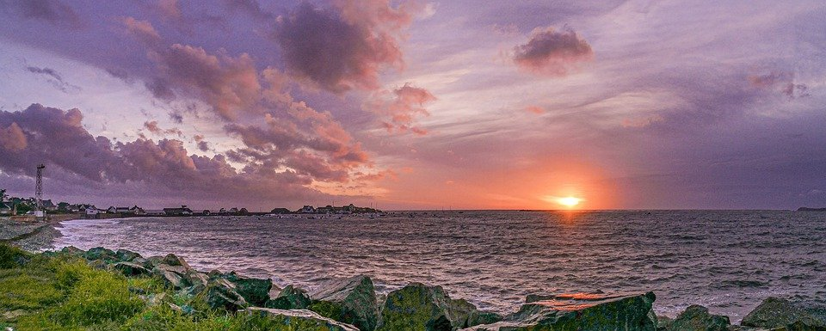
And it shall be said in that day, Lo, this is our God; we have waited for Him, and He will save us:
This is the LORD; we have waited for Him, we will be glad and rejoice in His salvation. Isaiah 25:9
Sunset
Prayer
Call

Slide 10
Sunset Prayer Call
Through the Lord’s mercies we are not consumed, Because His compassions fail not.
They are new every morning; Great is Your faithfulness.
Lamentations3:22-23

Slide 11
…and just as a bridegroom rejoices over his bride, so your God will rejoice over you.
“Upon your walls, I have posted watchmen; all day and all night they won’t remain silent.
You who make mention of the Lord, take no rest, and give Him no rest until He prepares, establishes and makes Jerusalem (His Church) a song of praise throughout the earth.”
Sunset Prayer Call

Slide 12
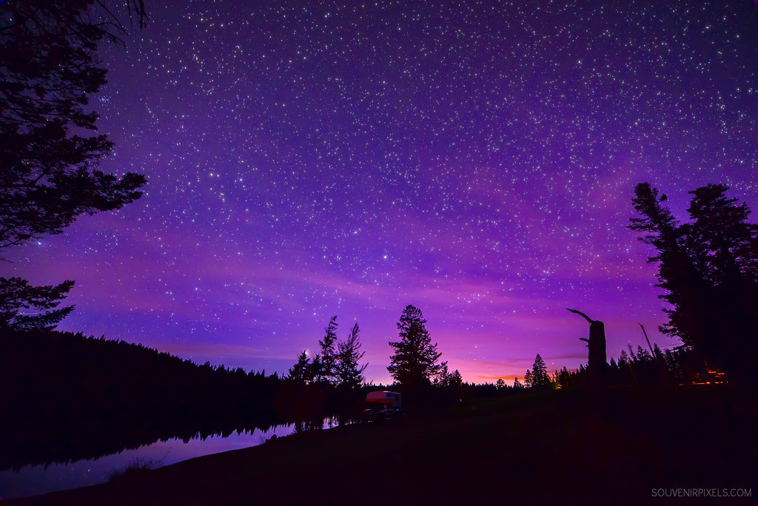
SUNDAY
NIGHTWATCH
PRAYER HOUR
Focus on: BUSINESS…WISDOM…PEACE

Slide 13
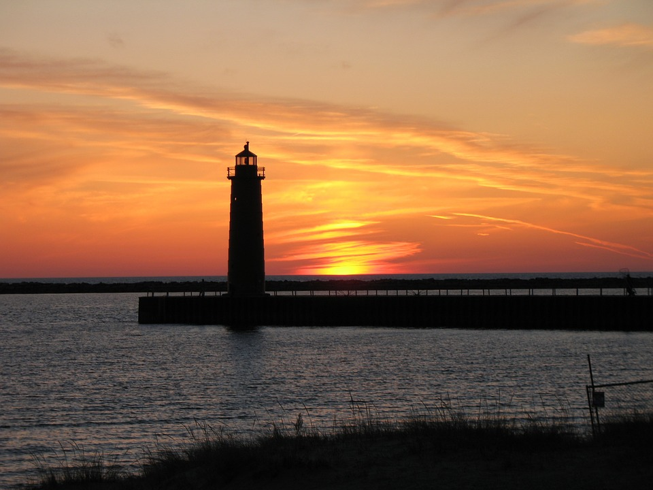
MONDAY
NIGHT WATCH
PRAYER CALL
Focus on: EDUCATION…PROTECTION…KINDNESS

Slide 14
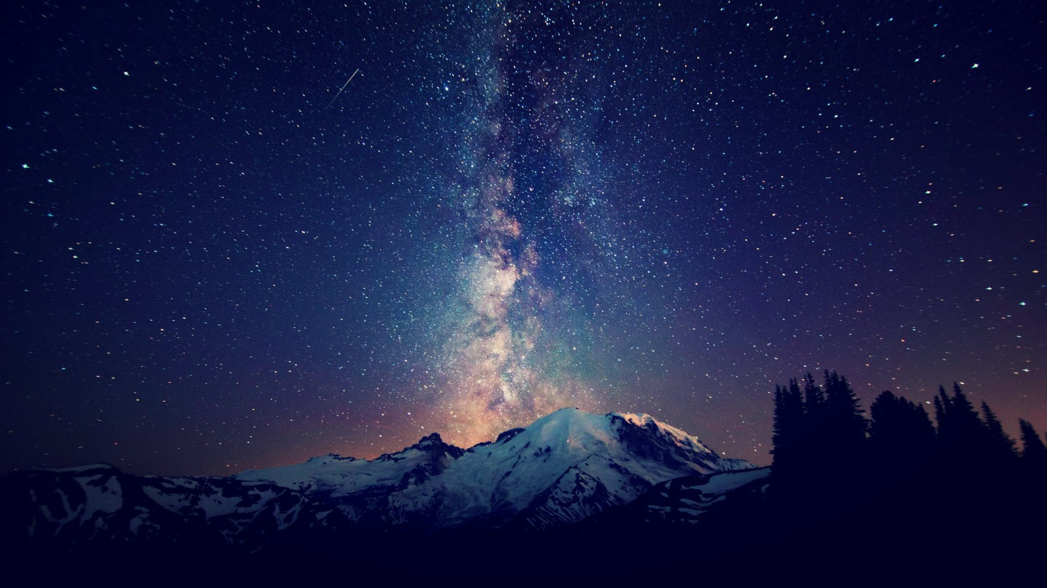
TUESDAY
NIGHTWATCH
PRAYER HOUR
Focus on: ARTS…ENTERTAINMENT…PROSPERITY…JOY

Slide 15
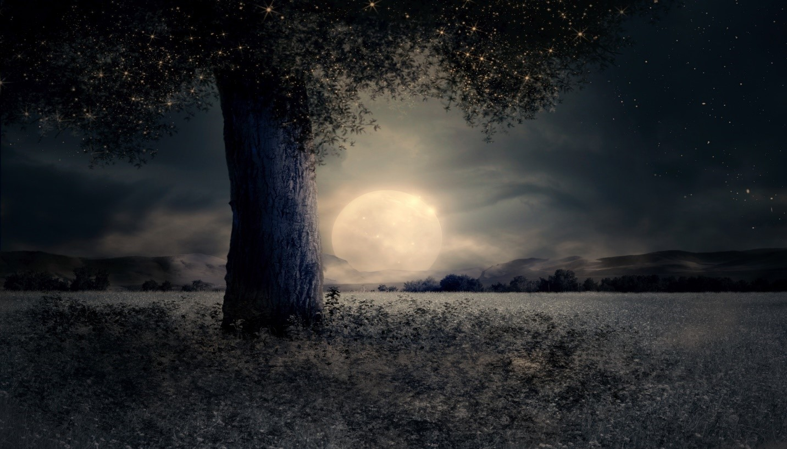
Focus on: GOVERNMENT…PROVISION…PERSEVERANCE…
WEDNESDAY
NIGHTWATCH
PRAYER HOUR

Slide 16
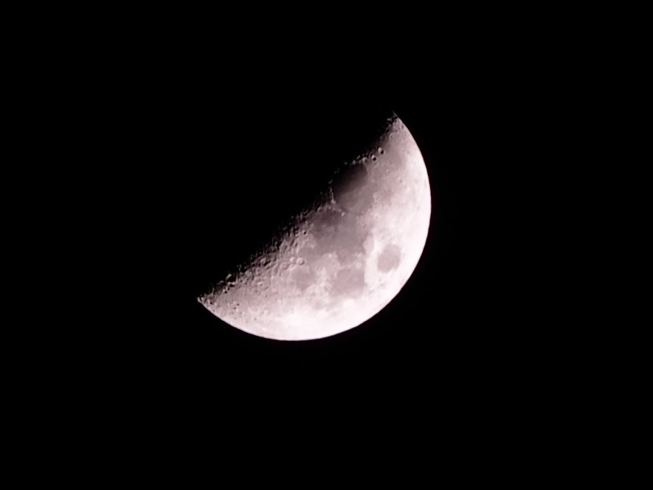
Focus on: FAMILY…TRUST…LOVE…
THURSDAY
NIGHTWATCH
PRAYER HOUR

Slide 17
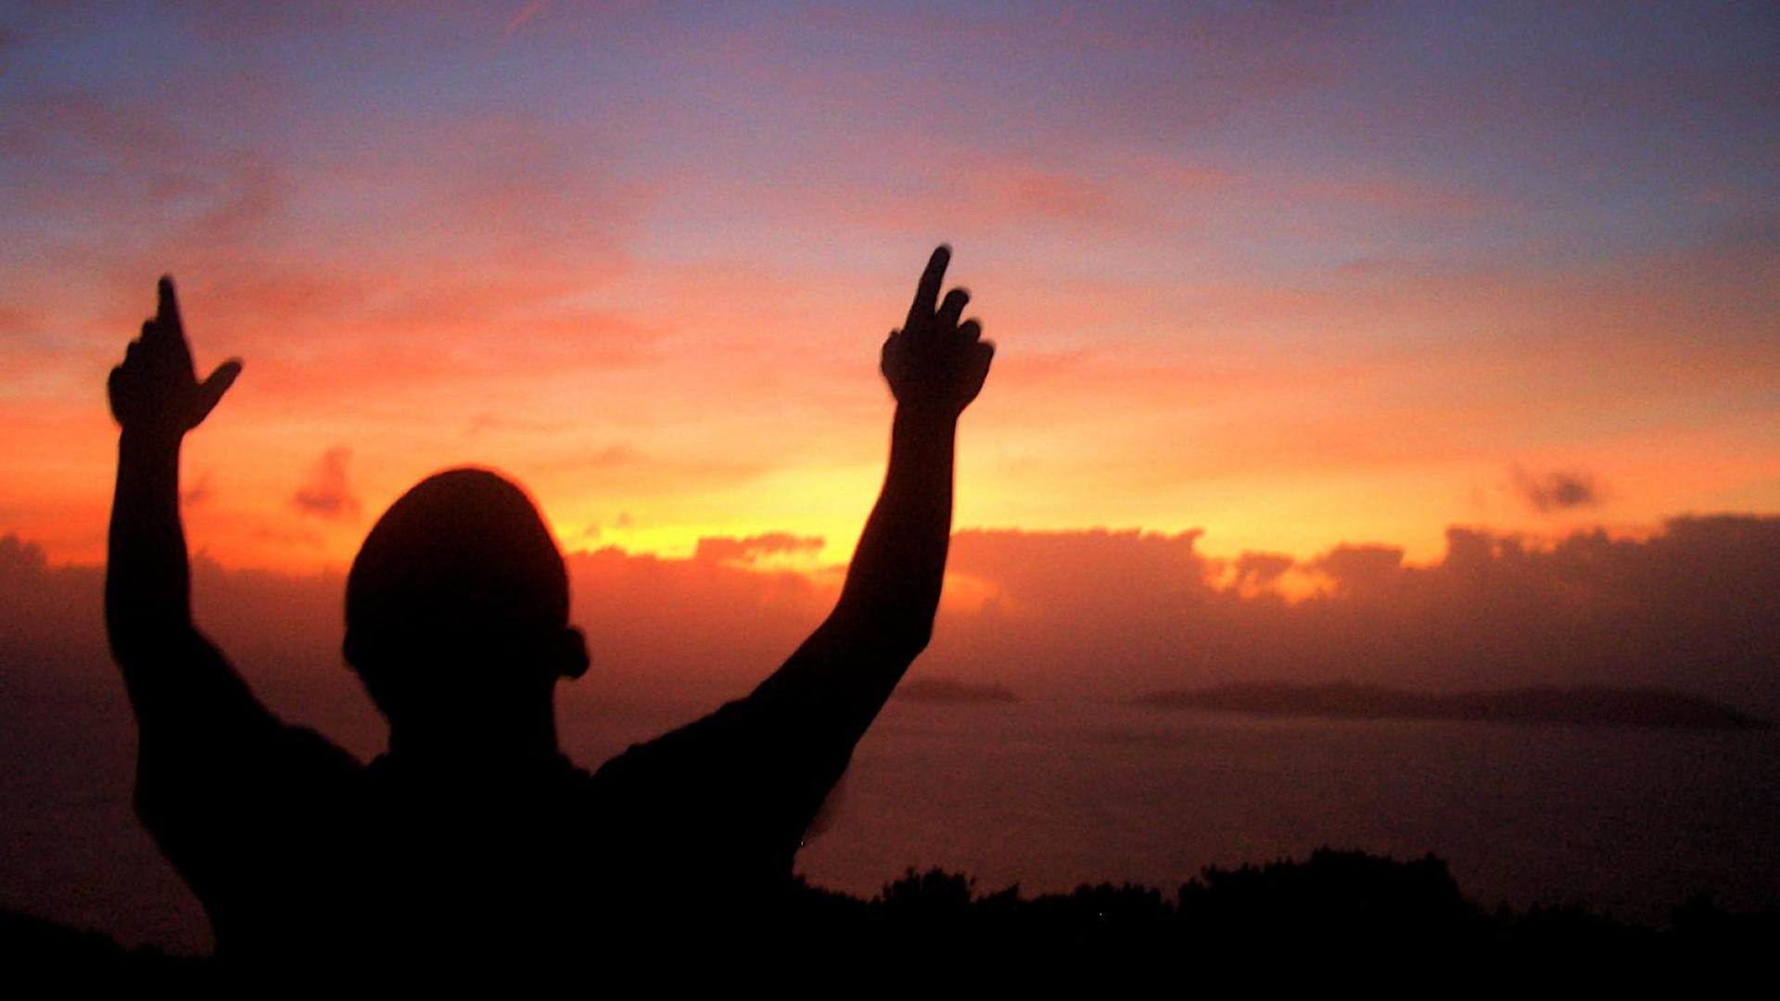
Focus on: MEDIA…TECHNOLOGY…BLESSING…PATIENCE…
FRIDAY
NIGHTWATCH
PRAYER HOUR

Slide 18
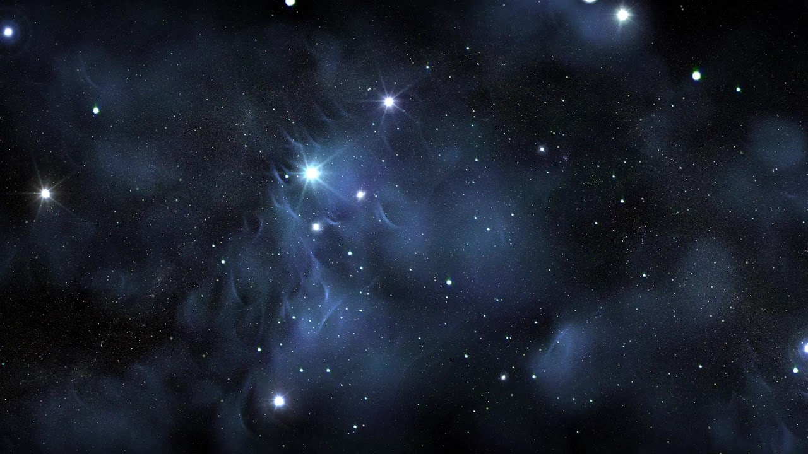
SATURDAY
NIGHTWATCH
PRAYER HOUR
Focus on: RELIGION…HEALING…FAITH…

Slide 19
Section Dividers

Slide 23
NIGHTWATCH PRAYER HOUR
Praise and PETITIONs
01
LIGHTNING STRIKES & Prayers for GOD’S WILL
02
Declarations of Victory & Thanksgiving
03

Slide 24
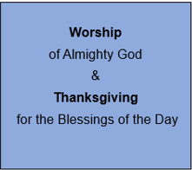
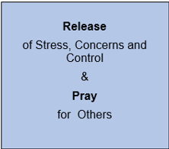
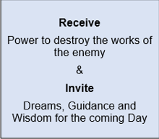
NIGHTWATCH INTERCESSORY PRAYERS

Slide 25
Awaken the Dawn
Praise and PETITIONs
01
LIGHTNING STRIKES & Prayers for GOD’S WILL
02
Declarations of Victory & Thanksgiving
03

Slide 26
Awaken the Dawn
WORSHIP and REMEMBER God’s promises
01
Bind the enemy with
Prayers for LEADERS, CHURCH & the nations
02
loose Victory & Thanksgiving
03

